Slide 1


AUDIO PLATFORMS - 2025

Slide 2



AM & PM DRIVE-DAYPARTS-ROS (6A-7P)
669 AFFILIATES
-SPORTS, NEWS/TALK, COUNTRY, CLASSIC ROCK, HOT AC, CLASSIC HITS, TOP 40
AM NEWS (6A-10A)
189 AFFILIATES
-SPORTS, NEWS/TALK, COUNTRY, CLASSIC ROCK, HOT AC, CLASSIC HITS, TOP 40
-LOCAL NEWS LISTENERS CAN USE,
NOT POLITICAL

Slide 3

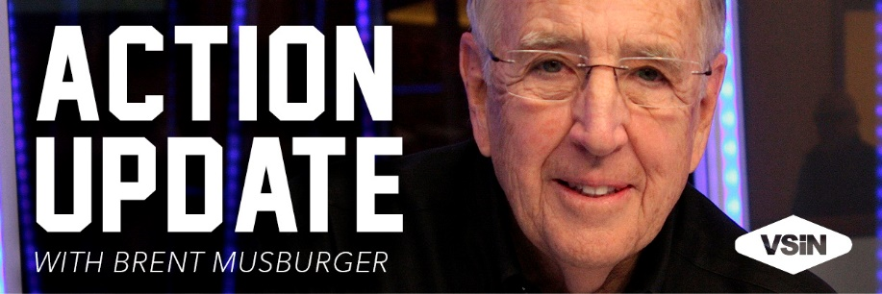
WEATHER (24/7/365)
208 AFFILIATES
-SPORTS, NEWS/TALK, COUNTRY, CLASSIC ROCK, HOT AC, CLASSIC HITS, TOP 40
-HOURLY UPDATES AVAILABLE
ACTION UPDATE (6A-7P)
281 AFFILIATES
-SHUT DOWN OF LONG-FORM NETWORK
-ELIMINATES OPEX
-MAINTAINS REVENUE STREAM

Slide 4

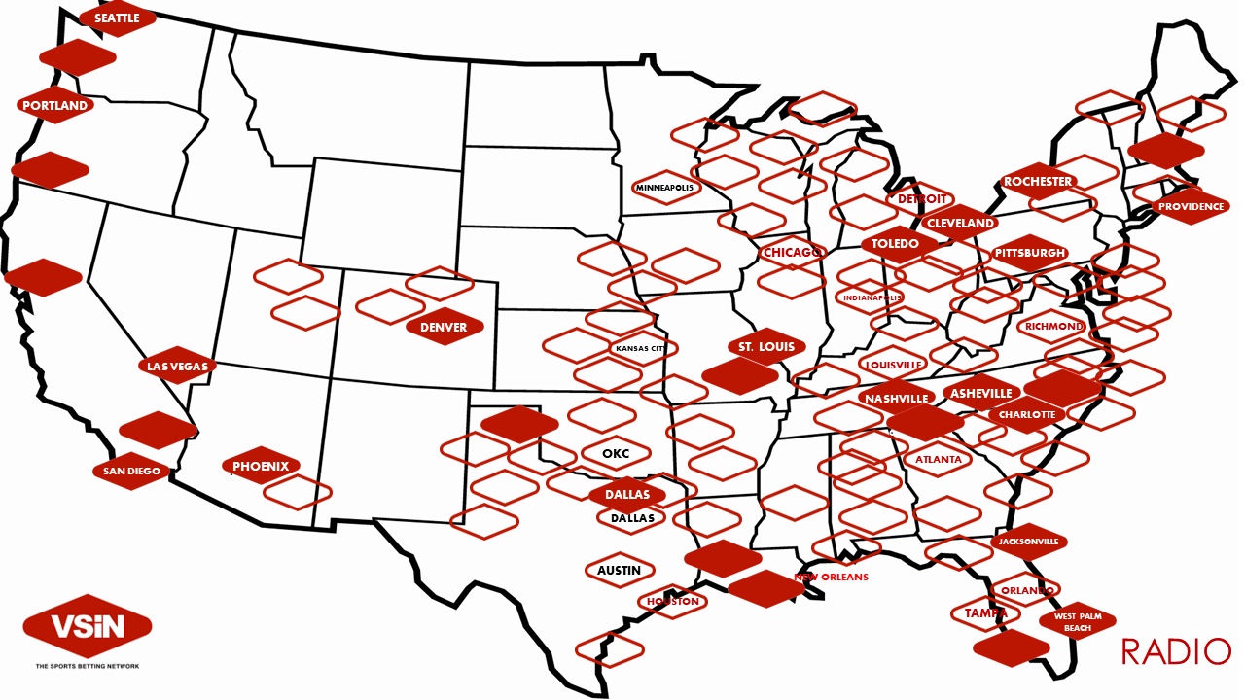






















24/7/365
350+ AFFILIATES

Slide 5
AUDIO PLATFORMS - 2025

