Slide 1



Gow Media
5353 West Alabama, Suite 415
Houston, TX 77056
(713) 479-5300

Slide 2

Table of Contents
Introduction 3
Our 24/7 Lineup 4
Top of the Lineup: Steve Czaban 5
Y! Sports Experts 6
Testimonials 7
Our Specialty Weekly Shows 8 – 12
  Wetzel to Forde
  Fantasy Freaks
  Rick Horrow
  Charlie Epps Golf Hour
  Mouthpiece Boxing
Affiliate Programs 13
On The Road 14
Contacts 15

Slide 3
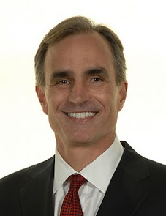
Thank you for your interest in Yahoo! Sports Radio. Yahoo! Sport Radio is the product of a deep partnership between Yahoo! Sports and Gow Media. We believe we stand apart from other sports radio networks for two primary reasons: (1) Content and (2) Collaboration.
Content: In the following pages you will see the compelling team of sports experts that forms our network. Our on-air cast starts with Steve Czaban, and includes Marty Tirrell and Bob Ryan, Travis Rodgers, etc. We also get consistent contributions from the team at Yahoo! Sports, including Dan Wetzel, Pat Forde, Michael Silver, Adrian Wojnarowski and many more. Simply, the combination of the team at Gow Media with the Yahoo! Sports experts creates the strongest pool of content in the industry.
Collaboration: We are continuing to identify and roll out new initiatives for our affiliates. Some of our latest additions include a new digital offering to enhance your web site, and an increased number of shows available via recording (e.g., Czaban, Wetzel/Forde, others) – which enables you to air a particular show within your local schedule. Also, I encourage you to inquire about our elite “Platinum 5000” program for top affiliates. This program, offered to a limited number of affiliates, provides a wide-ranging set of high value services, including special call-ins, marketing events and revenue-generation.
Finally, I can promise you this: you will find our team to be the most supportive, committed and collaborative group in the industry. We are not in the business of “forcing clearances”; we are in the business of working with you to find the right formula to support your station’s success. We have a great brand, a strong team of resources, and the commitment to be a great network partner.
Regards,
David Gow
Chief Executive Officer
Yahoo! Sports Radio
Gow Media

Slide 4
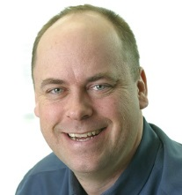
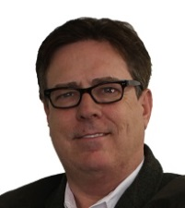
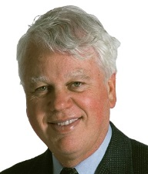
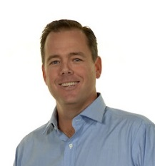
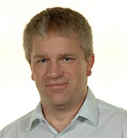
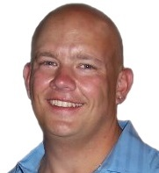
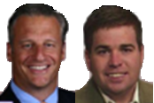
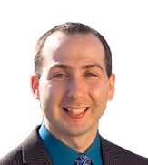
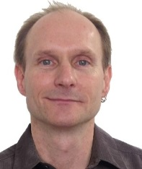
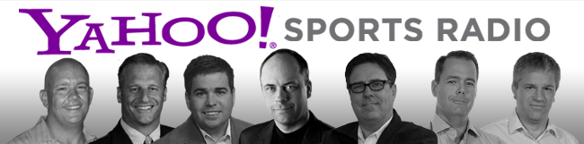
OUR STARTING LINEUP
The Steve Czaban Show
Monday – Friday
6:00 A.M. – 10:00 A.M.
See next page
Calling All Sports w/
Marty Tirrell & Bob Ryan
Monday – Friday
10:00 AM – 12:00 PM EST
Travis Rodgers Now
Monday – Friday
12:00 PM – 2:00 PM EST
The War Room
w/ John Harris
Monday – Friday
2:00 PM – 4:00 PM EST
Hit Em Up
w/ Geoff Ketchum
Monday – Friday
4:00 PM – 8:00 PM EST
Wetzel to Forde
Thursdays
8:00 PM – 10:00 PM ET
The Final Score
w/ Bryan Benway
Monday – Friday
10:00 PM – 1:00 AM EST
The Third Shift
w/ Terry Ford
Monday – Friday
1:00 AM – 6:00 AM EST

Slide 5
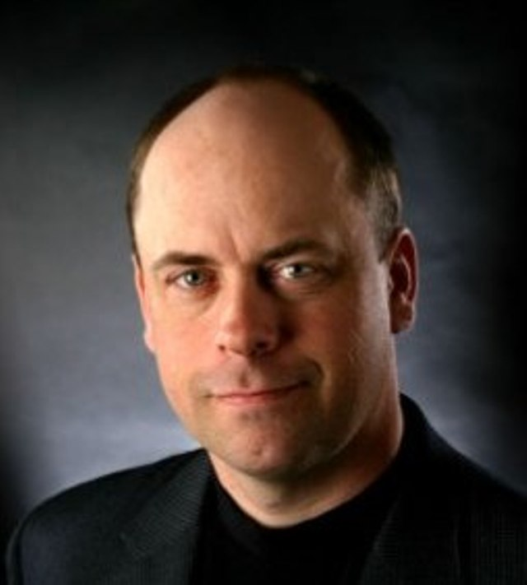
STEVE CZABAN
Monday – Friday
6a-10a ET
Wake up your market with the best morning drive sports talk show
Proven ratings winner in markets like Houston, Milwaukee, and Washington DC
Long history of brand loyalty that extends to listeners’ buying habits (e.g. – 5 Hour Energy)
Available for advertiser endorsement on a client by client basis
Track record of successful market appearances
Customized promos available for your market
Daily and weekly features available for local sponsorship (e.g. – Daily Czabe and SuperFriends)

Slide 6
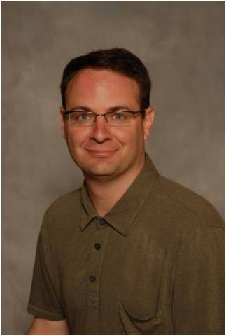
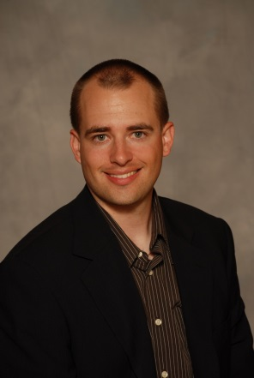
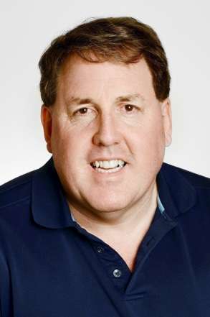
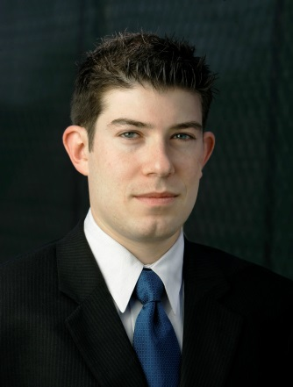
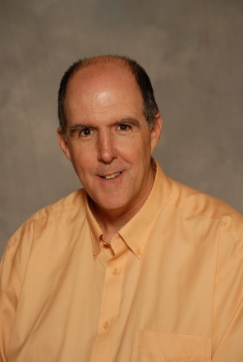
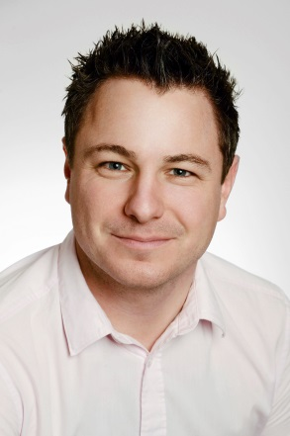
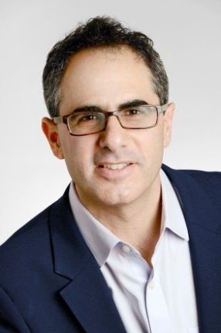
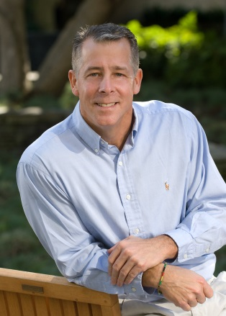
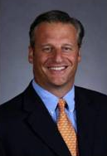
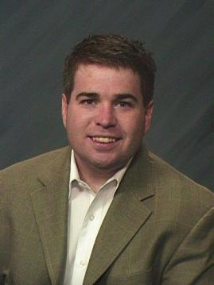
Yahoo! Sports Experts
Adrian Wojnarowski:
NBA
Brad Evans: Fantasy & Bracketologist
Jason Cole:
NFL
Jeff Passan:
MLB
Kevin Iole:
Boxing & MMA
Martin Rogers:
International
Mike Silver:
NFL
Tim Brown:
MLB
Pat Forde: National College
Dan Wetzel:
National Columnist

Slide 7
MAKING A DIFFERENCE
“We love having the Travis Rodgers Show on AM830 KLAA, he is a breath of fresh air when it comes to morning sports radio. He’s insightful, entertaining and engaging. His audience “gets” his humor and is responsive via calls and social media. This is different from the traditional morning sports show regurgitating the same news heard hours earlier. Travis Rodgers loves what he does and it comes across every morning.”
Bob Agnew, Program Director
AM830 KLAA in Los Angeles
“We are thrilled to have Calling All Sports on here in Boston. Marty is a true professional that can relate to the Boston Sports Fans and understands the passion of The Diehards. Also having a legend like Bob Ryan on the 1510 airwaves is an honor and is fantastic radio everyday! 1510 Yahoo Sports Radio will bring the listeners in the clubhouse, dugout, and locker room like no one else. Boston Sports Fans are one of the most passionate fan bases across the country and listening to 1510 Yahoo Sports Radio will give the listeners a season ticket to their favorite teams.”
Anthony Pepe, General Manager
WUFC 1510 AM in Boston
“Great talent, good content. I like these guys! I believe you can make money on their programming if you know how to approach the market. I am very excited to have them with us.”
Deirdre M. Palmer, General Manager
KEMP Broadcasting in Las Vegas
“I have worked with all the major sports networks and I can honestly say, no one provides more support and flexibility, than Yahoo!. We have had a tremendous response to The Steve Czaban Show in particular. Czabe is a legend in this business, and he brings an element of "Guy Radio" that works for us!”
- Thom Abraham, General Sales Manager
WNSR 560AM Nashville Sports Radio

Slide 8
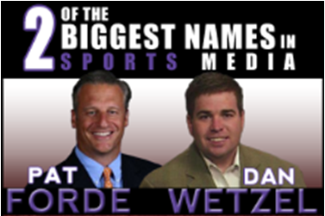
Weekly Shows:
WETZEL TO FORDE
Thursdays 8P – 10P EST
Fast paced show featuring unique story telling angles
Over 40 years of sports journalism experience between them
Show is recorded & can be downloaded/re-aired to fit within your local schedule
Pat Forde’s Forde Yard Dash column is one of the most read on YahooSports.com
Dan is a NYT Best Selling author who co-wrote Death to the BCS
Both Dan and Pat are available for interviews on your local shows (for Platinum 5000 members)
Potential station visit by Dan or Pat to coincide with event/game schedules
Customized promos available for your market

Slide 9
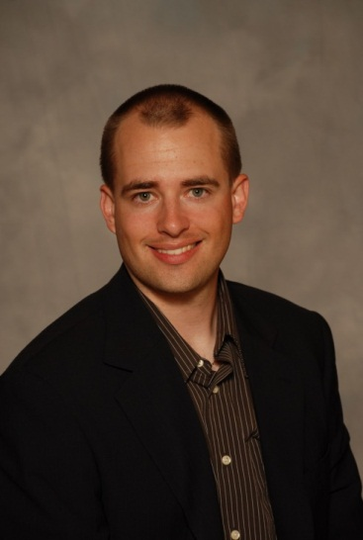
Weekly Shows:
FANTASY FREAKS
Fridays 8P-10P EST
…and beginning August 11, 2013
Sundays 9A–11A EST
Hosted by Yahoo! Sports’ resident fantasy expert Brad Evans
Year long show that focuses on all fantasy sports, not just football
Almost 40 million people age 12+ play fantasy sports in the United States*
Yahoo Fantasy Sports is one of the dominant hosts for all fantasy sports
Regularly have full bank of calls lined up well in advance of the start of the show
* research conducted by Ipsos Public Affairs for the Fantasy Sports Trade Association in 2012

Slide 10
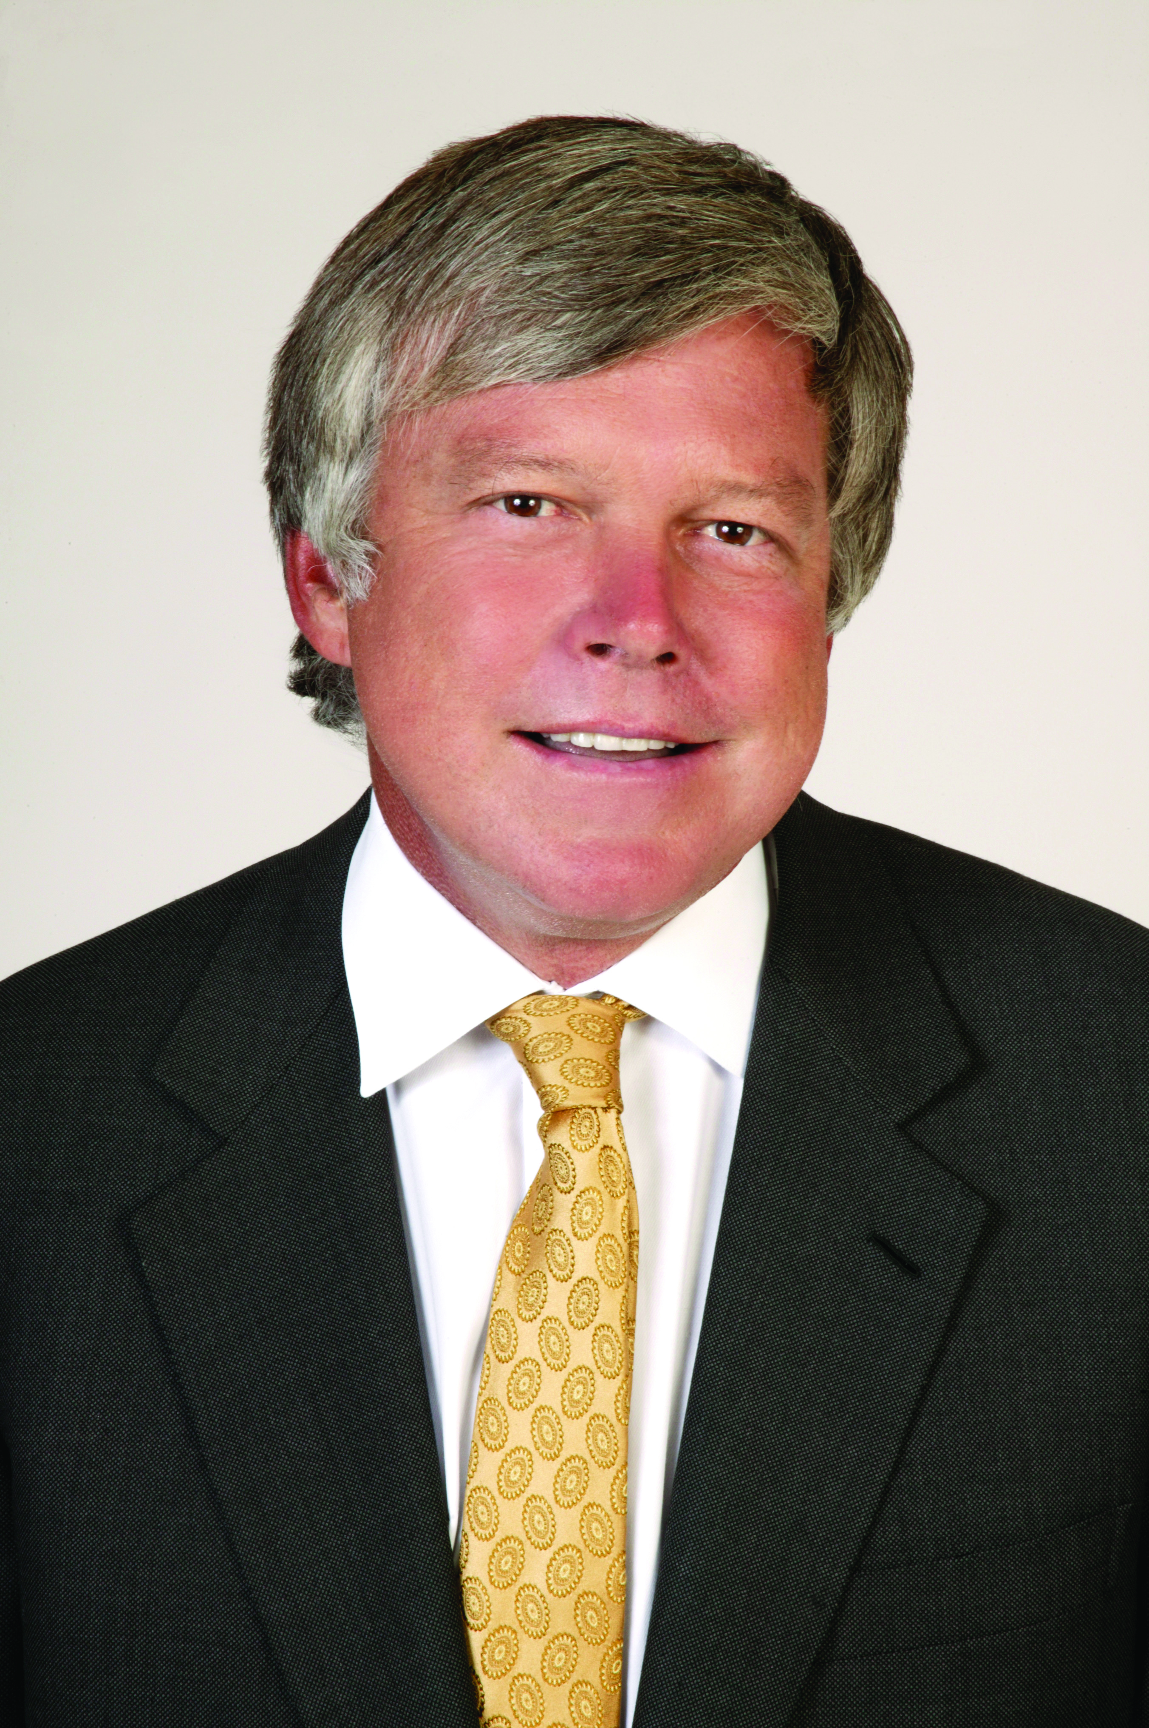
Weekly Shows:
RICK HORROW
The Sports Professor
Wednesdays 8P – 10P EST
Sundays 7A-9A EST
Rick is a leading expert in the world of sports business
As CEO of Horrow Sports Ventures developed over $13 billion in sports and of infrastructure projects
Visiting expert on sports law at the Harvard Law School
In addition to radio, Rick hosts the weekly “Beyond the Scoreboard” show on Bloomberg TV
Weekly appearance on your local shows available for local sponsorships
Recorded and available to air over the weekend to fit your lineup needs

Slide 11
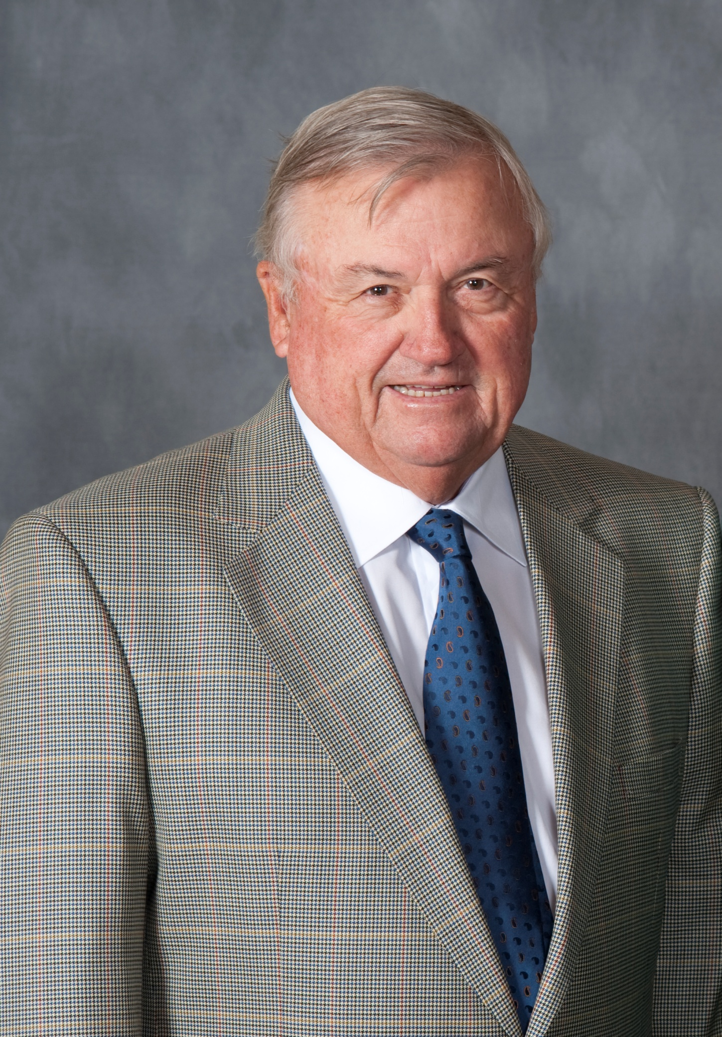
Weekly Shows:
THE GOLF HOUR with CHARLIE EPPS
Saturdays 9A–10A EST
Charlie Epps is swing coach for Angel Cabrera, 2007 US Open and 2009 Masters champion – runner up in Masters in 2013
Golf is a multi-billion dollar industry that reaches young and old with disposable income
Charlie attends every PGA Major and over 20 additional tournaments each year
Available for interviews on your local shows to preview any PGA event
Segments on golf technology and the latest gear available for local advertiser tie ins

Slide 12

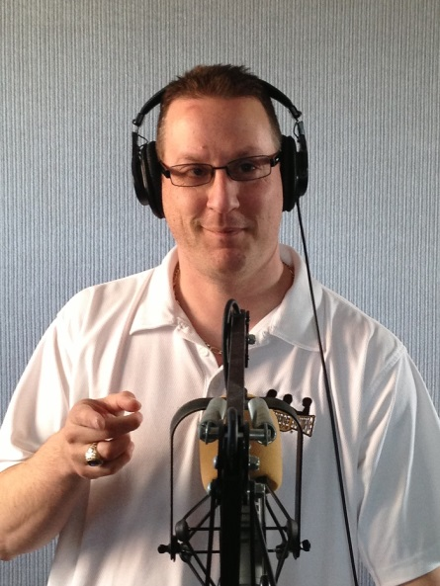
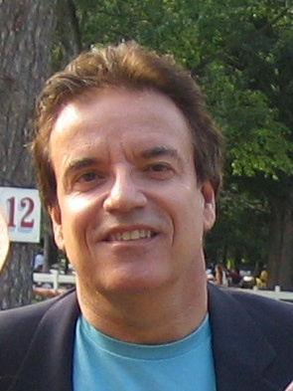
Weekly Shows:
Mouthpiece Boxing
with Anthony Pepe & Ron Borges
Fridays 10P- 11P EST
Anthony Pepe brought Mouthpiece Boxing to YSR from our Boston affiliate WUFC, making a once local program a national show
Mouthpiece Boxing covers championship fights from
Las Vegas to Atlantic City
to California and Florida
Ron Borges has been a fixture in Boston for over 30 years and currently writes for the Boston Herald
From Mayweather to De La Hoya to the legends of the boxing world, Mouthpiece Boxing has it all

Slide 13

Custom Sports Updates
Localized for your Market
Our “Sports Flash” product provides daily sports updates, customized for your market and station;
Includes “tags/ids” for your station – listeners assume it is a local station employee providing the updates;
Normal load is three per morning drive, weekdays;
Great opportunity to enhance local programming;
Highly saleable feature.
Great opportunity for cross promotion for your station

Slide 14
Affiliate Programs
Available to All Affiliates:
A great menu of on-air shows/content;
A new digital module of content for your site;
Call-ins to local shows from some show hosts;
Updates on new shows, specialty programs.
Our “Platinum 5,000” Program:
Daily, custom, play-by-play for your market;
Weekly call-ins to local shows from Yahoo’s “big three”;
Geo-targeted banner ads promotion your station;
At least one market visit per year by talent;
Participate in cross-selling programs for new revenue

Slide 15
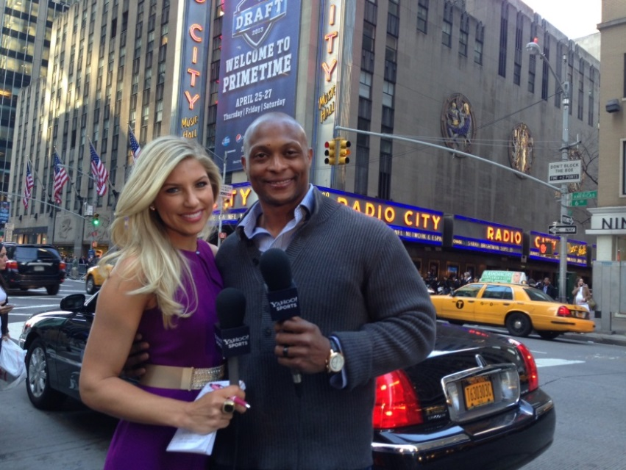
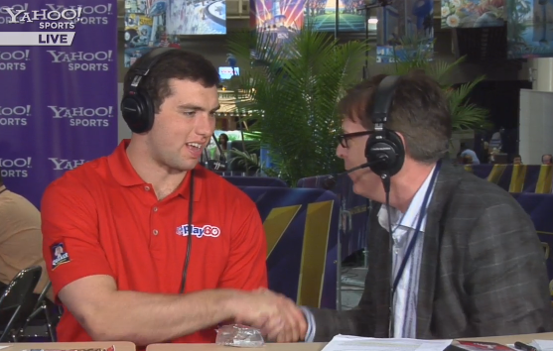
ON THE ROAD
Full coverage of the NFL Draft from NYC
Reports from team facilities across the country
Expert analysis of each pick as they happened
Over 40 hours of coverage from Super Bowl XLVII in New Orleans
Live reaction and from the Baltimore Ravens locker room
Yahoo Sports and Yahoo Sports Radio are at every major sporting event from the Kentucky Derby to the MLB All Star Game to the Stanley Cup Finals… and your station can be part of the excitement.

Slide 16
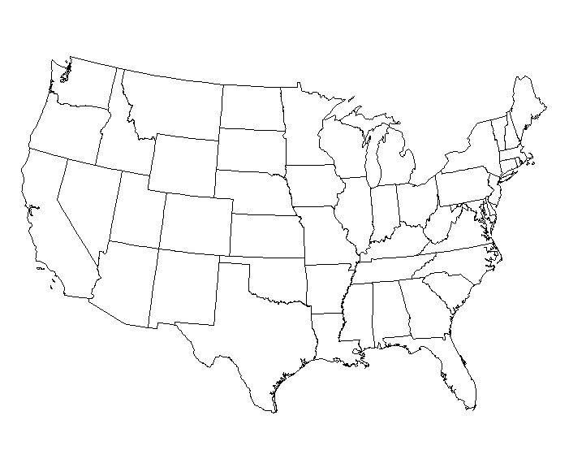

A TRULY NATIONAL LINEUP
Detroit –Dan Wetzel
Boston -- Bob Ryan,
Boxing
Des Moines -- Marty Tirrell
Santa Monica – Yahoo Sports
Lexington – Pat Forde
Washington - Steve Czaban
Los Angeles – Travis Rodgers
Austin – Geoff Ketchum
Houston – John Harris; Terry Ford;
Benway/Gwinn
Miami – Rick Horrow
During a 24/7 schedule, our lineup originates from al parts of the country – ensuring no geographical bias!

Slide 17
MANAGEMENT TEAM
David Gow, CEO
713-479-5302
Craig Larson, COO & Program Director
713-479-5373
Chris Morales, Head of Creative
818-585-3321
Josh Vexler, Director of Affiliate Relations
713-479-5358
Alex Baquiran, Affiliate Relations & Director of Web Content
713-479-5334
Benjamin Hamel, Affiliate Relations & Business Analyst
713-479-5375
Brandon Strange, VP of New Media
713-479-5375
Laura Beavers, Controller
713-479-5330

