Slide 1



AN INNOVATOR IN
SPORTS MEDIA & MARKETING
PRESENTS:

Slide 2
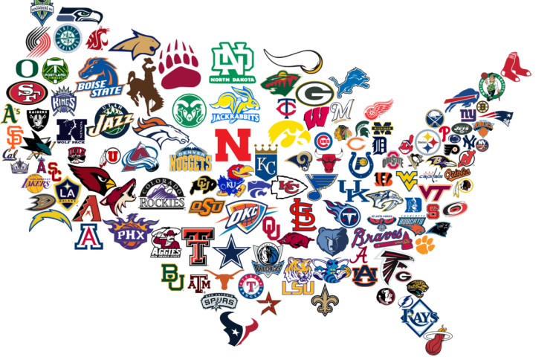
Today’s Radio Reach Large
Over 550 affiliate radio stations across the country – over 150 taking shows and over 400 taking updates
Satellite channel 92 taking 4-6 hours daily
Large and growing mobile listenership
6M+ listeners each week across all platforms
We maintain our existing affiliate base for radio reach, while positioning for stronger digital growth

Slide 3
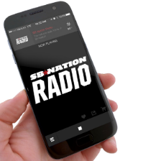

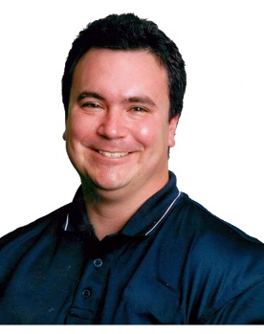


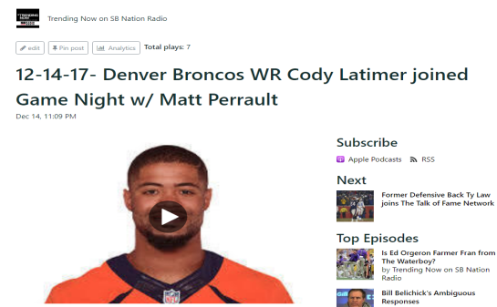
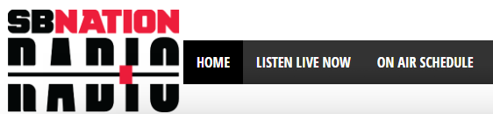
Large, Multi-Platform Reach
Audio on Mobile
Large number of mentions to be heard over all our platforms.
The Flagship in Houston:
Podcast of shows
and the network of affiliate radio stations
Large # of openings of short-form audio-on-demand via “push”/display onto other sites
Satellite
Live Stream

Slide 4
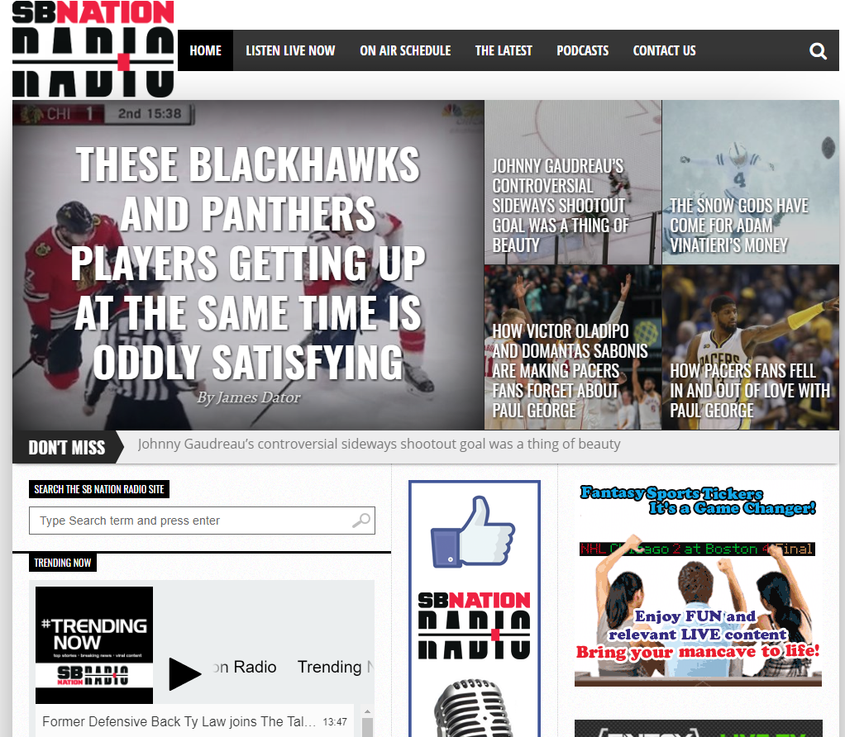
Our Radio Site
URL: SBNationRadio.com

Slide 5





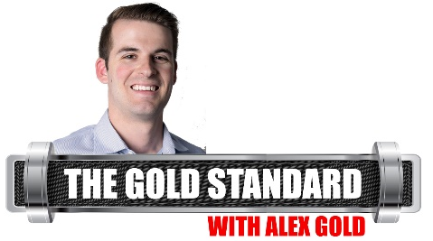
Weekday Line Up
1am
6am
10am
1pm
4pm
8pm
10pm

Slide 6
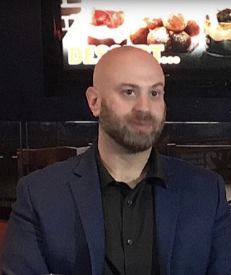
The Second Level w/Eytan Shander
1 AM – 6 AM EST
Eytan is a fourteen-year talk radio veteran and has been doing local TV in Philadelphia for the past three years. He is currently hosting at 97.3 ESPN in South Jersey and contributing at FOX29 in Philadelphia. A New York City native, Shander has been a staple on the Philadelphia airwaves for the past decade. He’s hosted at top stations like WIP and WPEN in Philadelphia, while doing sports analysis on FOX29 and NBC Sports Philadelphia. He spent two years working as a host and locker room correspondent for an ESPN station in Nashville, TN. Shander currently does national shows for SB Nation Radio and was previously on NBC Sports Radio and Sirius/XM. He has two digital shows as well, including one with Brian Westbrook. Shander currently lives in Philadelphia and travels as often as he can to OCMD.
@shandershow – Twitter/IG | Eytan Shander - Facebook

Slide 7

Tony Desiere & Ronn Culver
SB Nation AM
6AM - 10AM, EST Mon-Fri
Tony Desiere has been broadcasting for over 20 years going back to high school in New Hampshire where he did play-by-play on the basketball coach’s game tape. That led him to a communications degree and a job at the largest news/talk station in the state. Since then his career has had stops in Las Vegas, Denver, Colorado Springs and Nashville. He arrived at Yahoo! Sports Radio in 2012 which became SB Nation in 2016. Tony is a huge fan of SEC football, attended college at South Carolina and loves the in house battles with his Florida Gator wife Lori. He also spends as much time on the golf course as his two kids will allow.
Ronn Culver got his first big break reading the morning announcements in junior high and from then on out, he knew he had a face for radio. He studied Radio, Television & Film at California State University, Northridge and after failing to make it as a regular cast member on Friends he turned his efforts to teaching elementary school kids. Living in Southern California and then Hawaii, Ronn traded in his surfboard for a microphone in 2014 and moved to Houston where he currently holds the position of Executive Producer of SB Nation Radio. Ronn is always humbled by his wife and their three boys who know that his love of sports comes second only to his love of his family.

Slide 8
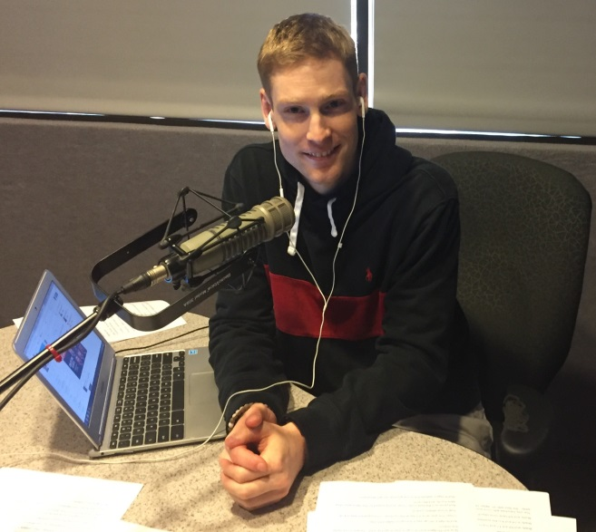
Brian Barrett
10A-1P
The Break
2013 was Brian’s first busy year as a National update anchor also hosting The Break, the NCAA Selection Show and Around the NFL with Sean Salisbury.
Prior to Gow Media, Brian covered Virginia Tech, the University of Virginia, the Washington Redskins, and the Washington Nationals. Brian is a graduate of Syracuse University, and spent two years hosting pre and post game coverage for Syracuse basketball and football.
He says he could eat grilled chicken every day for the rest of his life.

Slide 9
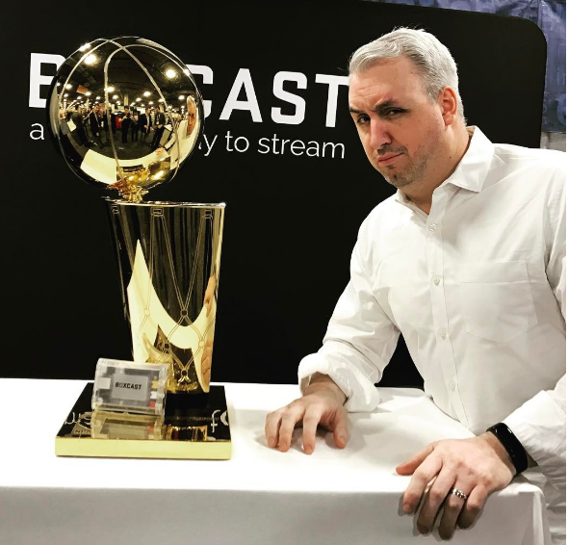
Matt Perrault
Pushing The Odds
Mon-Fri, 1 PM – 4 PM EST
Matt Perrault started in sports talk in 1996. Pushing The Odds with Matt Perrault originates from the Las Vegas Strip every week day. Never shy to voice his opinions, Perrault is known for owning the ears of his loyal fans. His honest approach to sports talk radio and engaging style have attracted an audience that enjoys interacting with him every night from coast to coast.

Slide 10
The Main Event
Jake Asman & Cody Stoots
Mon-Fri 4PM – 8PM EST
Jake Asman brings his energetic, unique, and humorous personality to SB Nation Radio. Jake comes to SB Nation Radio after hosting the morning show on Long Island’s SportsOnTheGo1 Radio. Asman has broadcasted live from Radio Row at both Super Bowl LI in Houston and Super Bowl LII in Minneapolis. In addition to hosting the daily radio show, Jake was an Associate Producer at WFAN Sports Radio and CBS Sports Radio in New York City and worked as a Production Assistant at NBC Sports during the 2018 Winter Olympics in Pyeongchang. In the summer of 2016, Asman interned with NBC Sports on site at the Rio Olympic games.
A native of Long Island, New York, Asman is a passionate fan of the Yankees, Jets, Knicks, and Islanders. Asman graduated with a degree in communications from Ithaca College in 2017.
You can follow Asman on twitter at @JakeAsman
Cody Stoots comes to SB Nation Radio from Houston where the majority of his professional career has been spent. Stoots is thrilled to be talking sports from his hometown of Houston covering the Texans for ESPN 97.5 and SportsMap.com as their lead contributor and spending weekends in the fall consuming copious amounts of college football. He's going into his seventh year as a Heisman Trophy voter and is also a member of the Pro Football Writers of America. Sports is the toy department of life and Stoots can't wait to get playing on SB Nation Radio.

Slide 11

Alex Gold
10PM – 1AM EST
Alex Gold grew up in the Kansas City area with a passion for sports beginning in his childhood. Most Sunday’s involved going with his family to the Kansas City Chiefs games and being around sports. His passion for broadcasting began all the way back in High School when he would anchor the schools sports television broadcasts.
Gold graduated from the University of Kansas with a degree in broadcast journalism. His first job was a utility role that included hosting the night show at 610 Sports Radio in Kansas City. Most recently, Gold comes from ESPN Boise in Boise, ID where he was a afternoon sports talk host. Expect a fresh, fun and energetic show ranging from sports to life from Gold.
Gold is a huge NFL and college hoops fan, and thinks March Madness is the best few weeks of the year. Outside of sports Alex loves the craft beer scene, talking sports betting as well as being a bit of a technology geek.
When he isn’t on-air you’ll probably find him on Twitter tweeting about anything he comes across while out and about. You may even spot him out walking his dog Zoey.

Slide 12
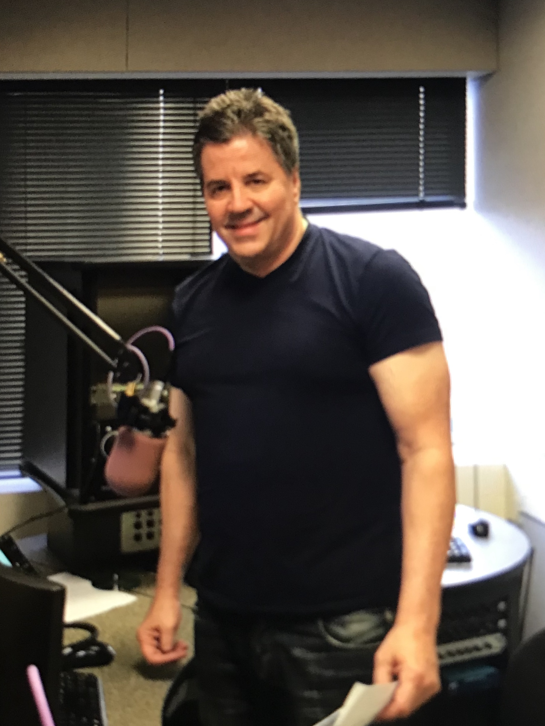
Dave Smith
Thurs 8PM– 10PM, Sat & Sun 9PM – 1AM EST
National and local sports-talk show host for 25 years in Los Angeles and Portland.
National shows were for Sporting News Radio and most recently NBC Sports Radio.
Afternoon and morning drive in Los Angeles for KMAX 107.1 FM, AM 570, 1540 The Ticket, AM 830 and 980 The Beast
In Portland I did mid days for 750 The Game.
Four time winner of "Los Angeles' Best Sports-Talk Show Host" by the Los Angeles Daily News
Hosted the pre and post game shows for the Lakers, Dodgers, Angels, Clippers, USC and UCLA football and basketball, the Portland Trail Blazers and University of Oregon football and basketball.
Host of "Lakers Insider" show with Jeanie Buss and Kurt Rambis, The "Pete Carroll Show," the "Chip Kelly Show," "Blazers Talk" and many others.
Was a regular guest on the Fox News Channel.
Once a week guest on "Sports Roundtable" on Fox Sports in Los Angeles.
Regular guest on "I Max" on Fox Sports.
Known for being opinionated, funny and topical.
Was once playfully lifted up into the air in the Lakers locker room by Shaq after criticizing him on the air.
Broke the story of Shaq coming to the Lakers, which was covered by Fox News, CNN and led to a segment with Jim Hill on CBS News.
Show segments include "Man Card Violations," "Sunday 6-Pack" and "The Roundtable."

