Slide 1
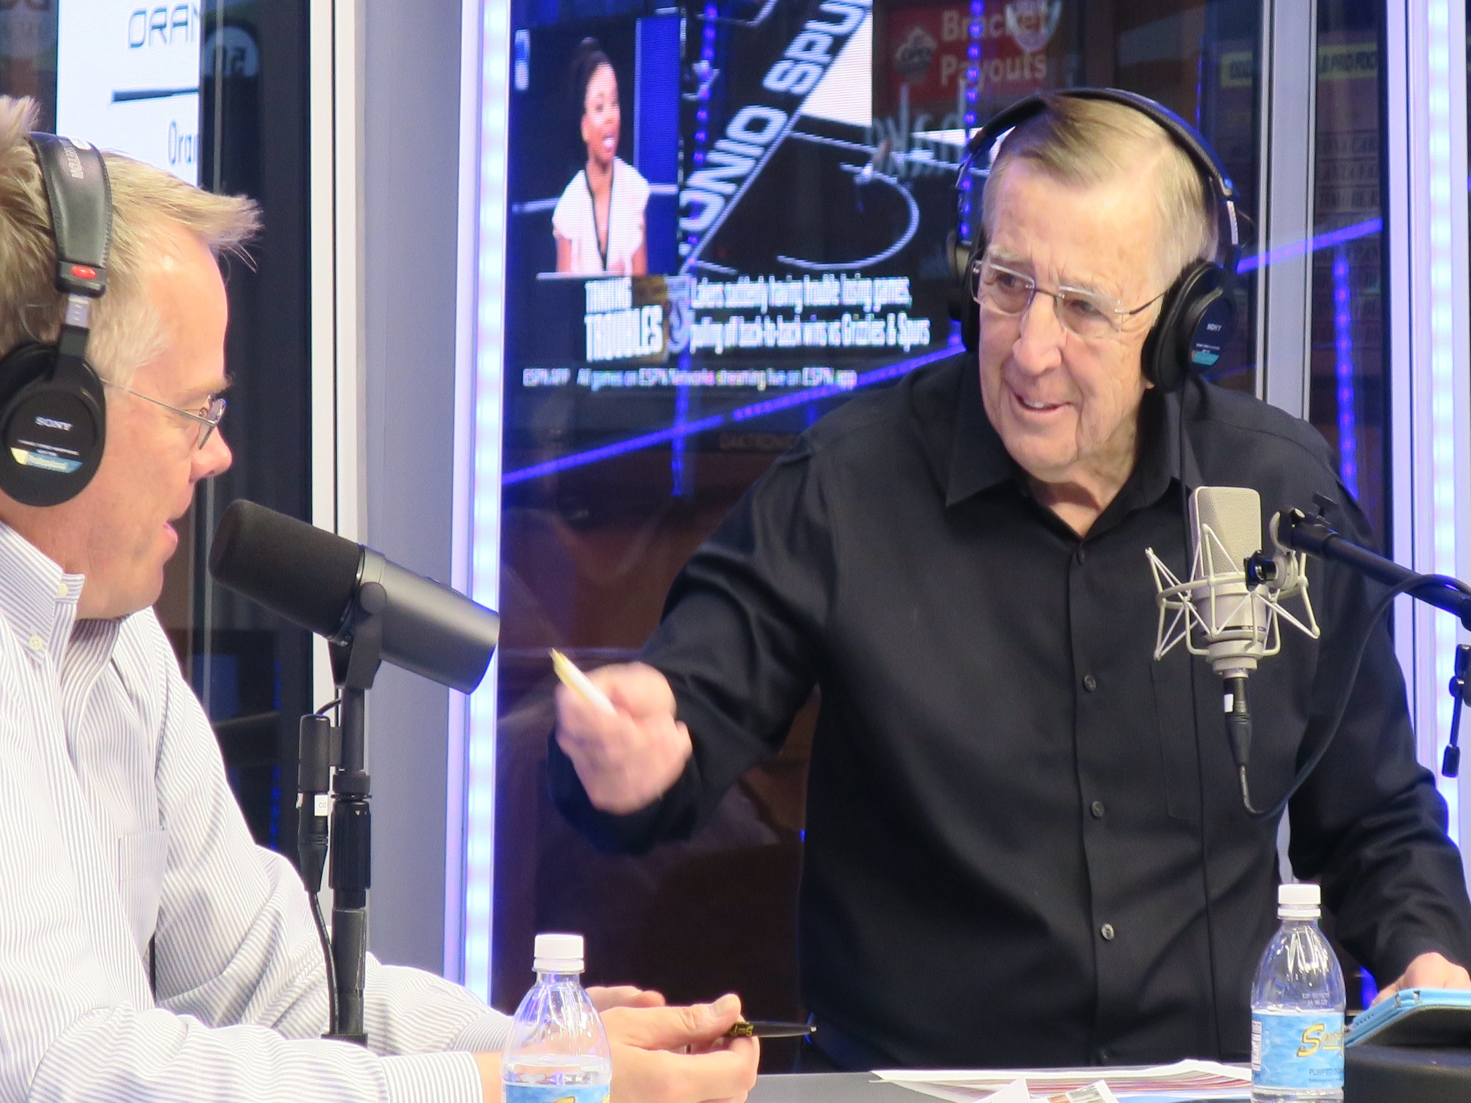
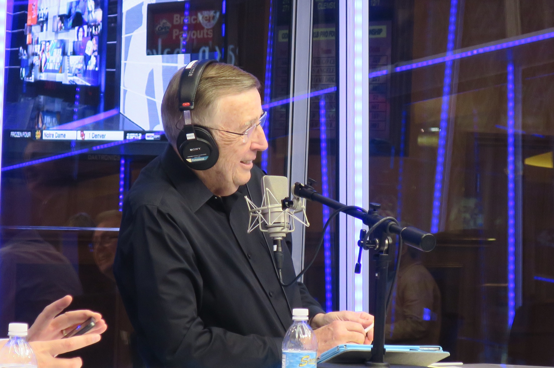
Radio Platform for the
VEGAS STATS & information NETWORK

Slide 2


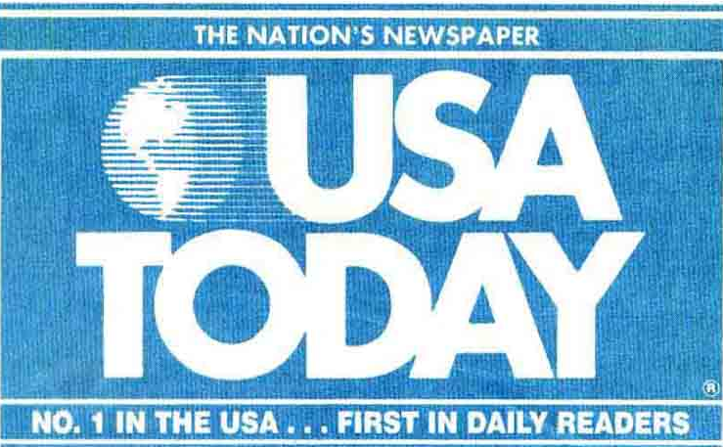

Supreme Court Ruling Favors Sports Betting
WASHINGTON — The Supreme Courtstruck down a 1992 federal lawon Monday that effectively banned commercial sports betting in most states, opening the door to legalizing the estimated $150 billion in illegal wagers on professional and amateur sports that Americans make every year.
May 14, 2018
Supreme Court strikes down ban on sports betting
The justices declared unconstitutional a law passed by Congress a quarter century ago that forced states to keep sports gambling bans on the books. The 6-3 decision clears the way for other states to join Nevada in allowing bets to be placed on individual games.
May 14, 2018
Supreme Court Ruling Opens Door to Sports Betting
WASHINGTON—The Supreme Court opened the door to legal sports betting across the country by invalidating federal prohibitions on such wagers, in a ruling Monday that could mark a groundbreaking shift for sports leagues, fans and casinos.
Updated May 14, 2018 7:17 p.m. ET

Slide 3
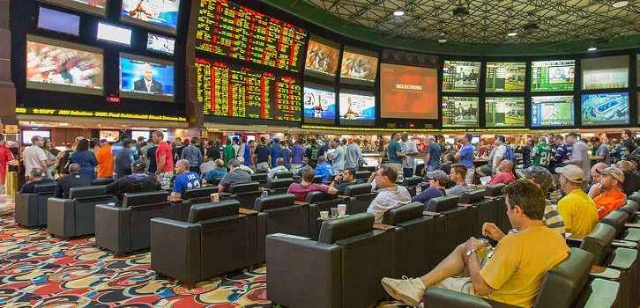

39% of adult Americans – about 100 million people – are either current or potential future sports bettors.
46% of current sports bettors in newly legalized states report that legalization has led to an increase in sports betting frequency.
Nearly 8 in 10 Americans support legalizing sports betting in their state.
63% of Americans support the Supreme Court’s ruling that struck down the sports betting ban.
Current and Future Sports Betting Behavior Post-PASPA
A survey conducted by the American Gaming Association

Slide 4

69% MALE
younger 45% sports bettors 25-34 demo
diverse 41% multi-cultural
educated 53% bachelor’s degree or better
-45% of sports bettors fall into the 25-34 demographic
-69% of sports bettors are male
-41% are multi-cultural
-69% of sports bettors have an annual income of $50,000+
-53% of sports bettors have a bachelors degree or better
earners annual income $50,000+
69% MALE
audience
Demographic profile from the American Gaming Association

Slide 5
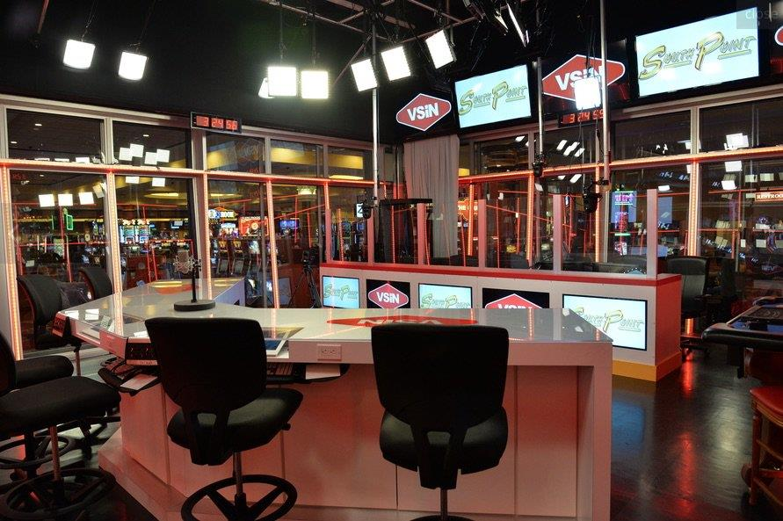
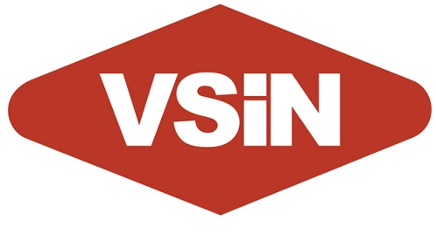
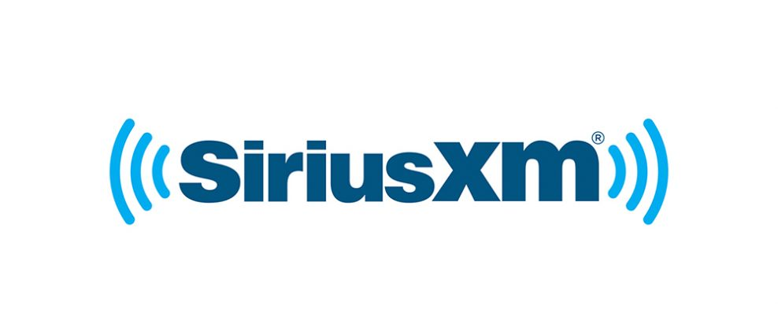
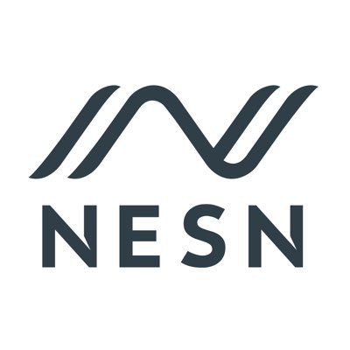



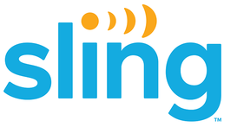
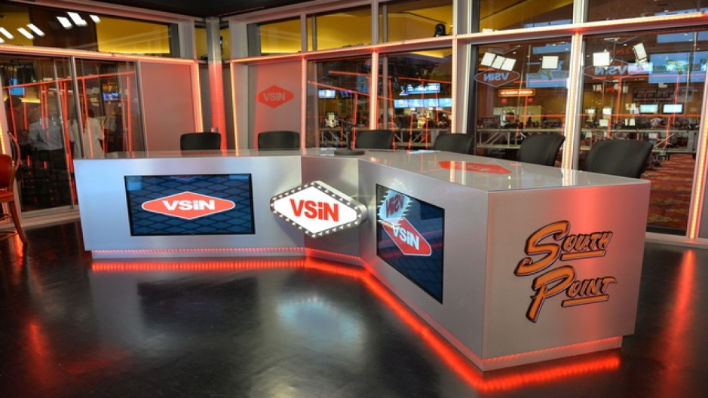
The Vegas Stats & information Network (VSiN) is the nation’s first-ever network dedicated to delivering news and information about the nation’s regulated betting markets. VSiN programming is distributed on multiple platforms across North America, including: SiriusXM; MSG Networks; the New England Sports Network (NESN); fuboTV; sling TV; and game+ in Canada. “The BetR Network” is VSiN’s radio platform and is the first-ever terrestrial radio network dedicated to sports betting.

Slide 6
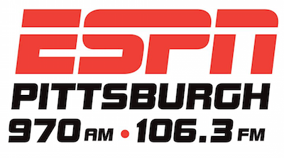
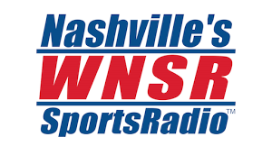
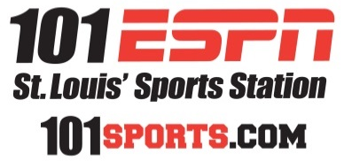
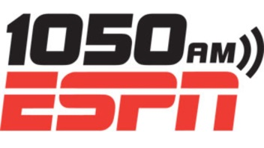



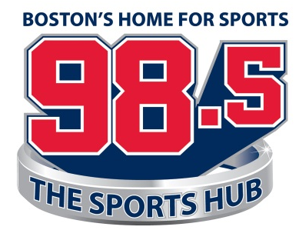



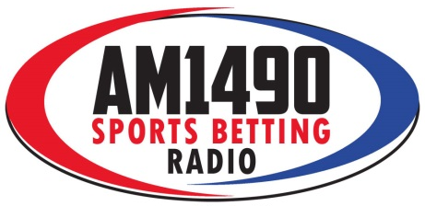
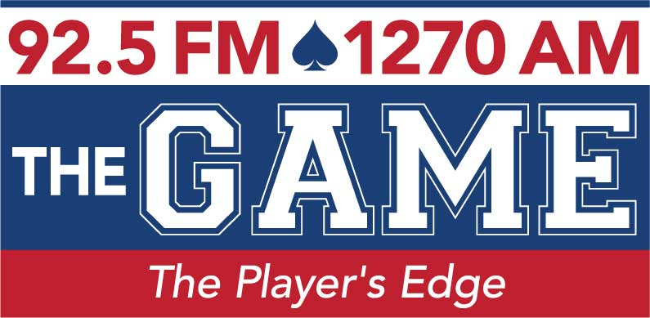
Nashville
St. Louis
New York
Chicago
Philadelphia
Boston
San Francisco
Portland
Louisville
Las Vegas
Pittsburgh
Atlantic City
Reno

Slide 7




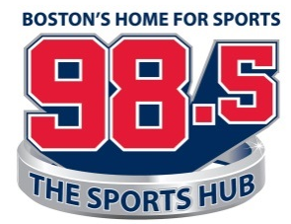
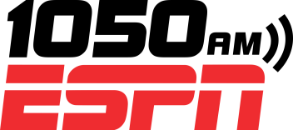


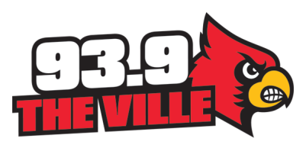
Brent Musburger’s Action Update
Vegas Stats & information Network
New York
Chicago
Boston
OVERVIEW
Gow Media produces and distributes the Brent Musburger Action Update for the Vegas Stats & Information Network (VSiN). The short-form feature delivers relevant, real-time sports betting news and information.
SPORTS BETTING
The recent U.S. Supreme Court ruling has sparked an unprecedented expansion of sports gambling in the United States. Sports gambling is going mainstream, and there are millions hungry for sports gambling content.
EFFECTIVE
Our Action Updates wrap your advertising message around essential content that the listener wants to hear. This will help your advertising message to cut through the clutter and deliver an significant impact for your business.
CONSISTENT
The VSiN updates air during morning and afternoon drive on many of the biggest radio brands in the country, including: 1050 ESPN New York (WEPN-AM); Boston’s 98.5 The Sports Hub; 890 WLS-AM in Chicago; and Philadelphia’s 97.5 The Fanatic (WPEN-FM).
AFFORDABLE
With each live read, the legendary Brent Musburger will wrap your advertising message around content the listener wants to hear during prime time on many of the biggest sports radio stations in the country.
Philadelphia
San Francisco
Houston
St. Louis
Portland
Pittsburgh
Louisville

Slide 8
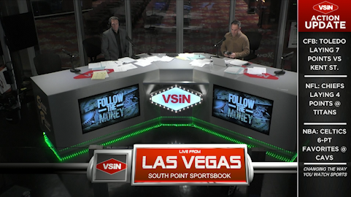

“Action Update” Presenting Sponsor

Slide 9
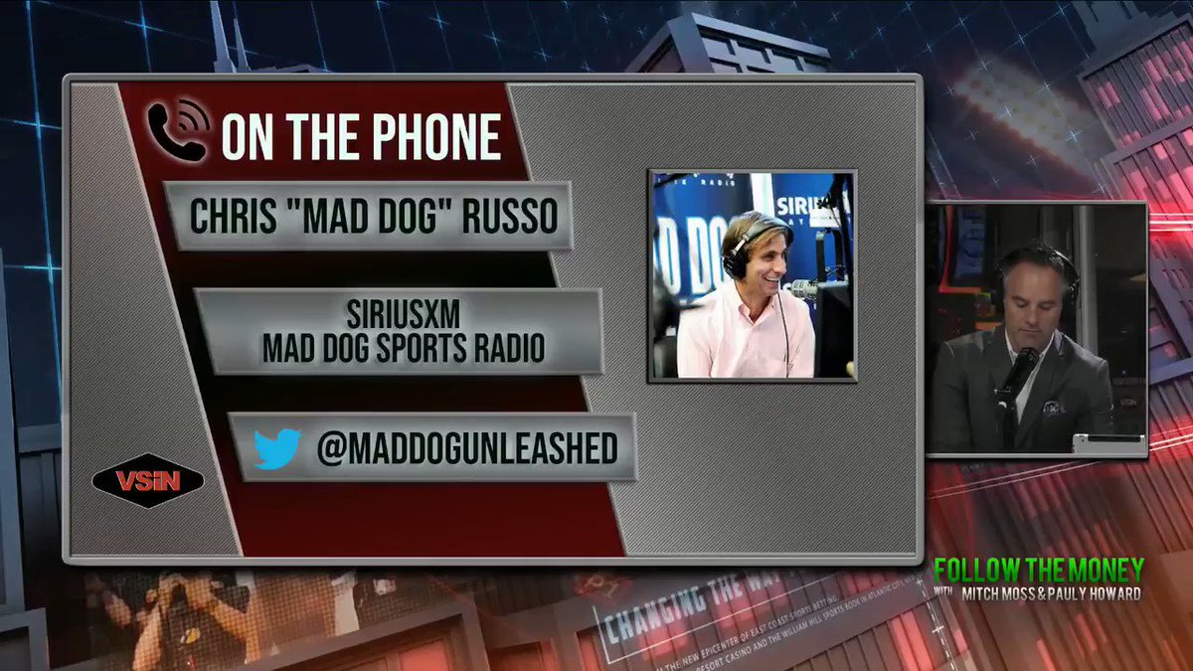
Guest Line Presenting Sponsor

Slide 10
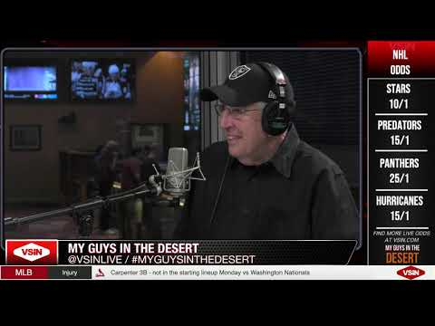
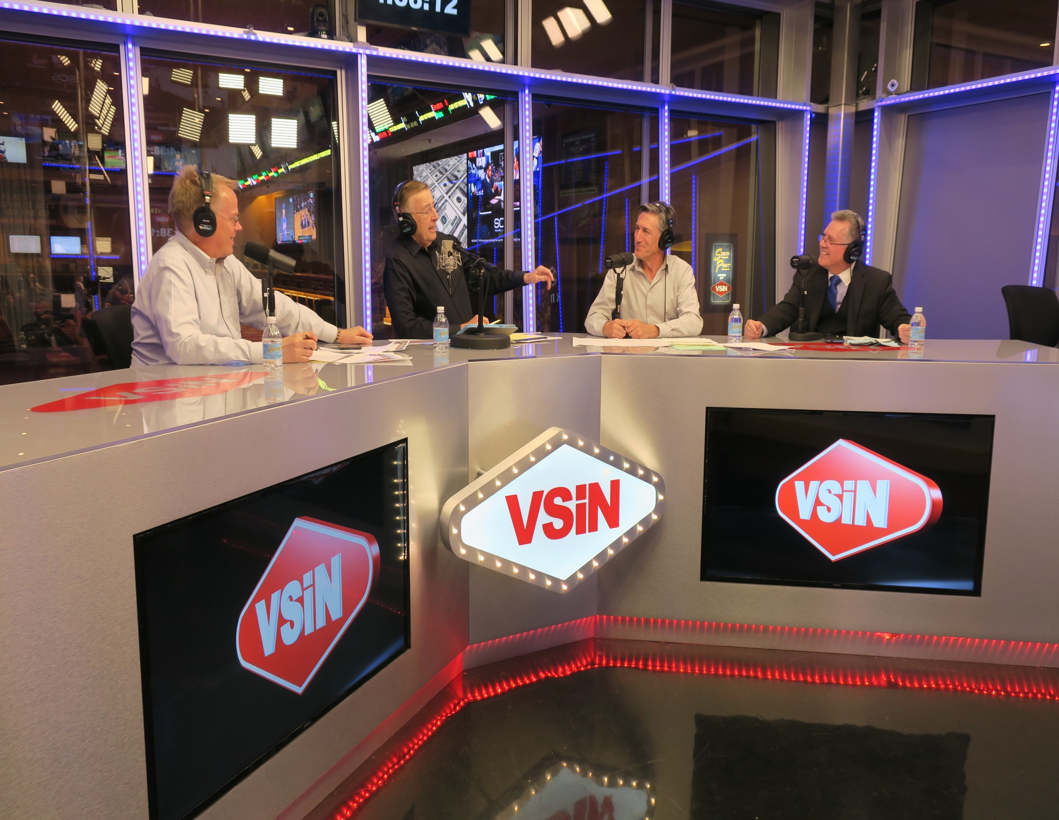
Studio Naming Rights

Slide 11



TOTAL
AUDIENCE
PLAN
31-MILLION MONTHLY IMPRESSIONS*
*Audience data provided by networks and represent impressions, not households.

