Slide 1
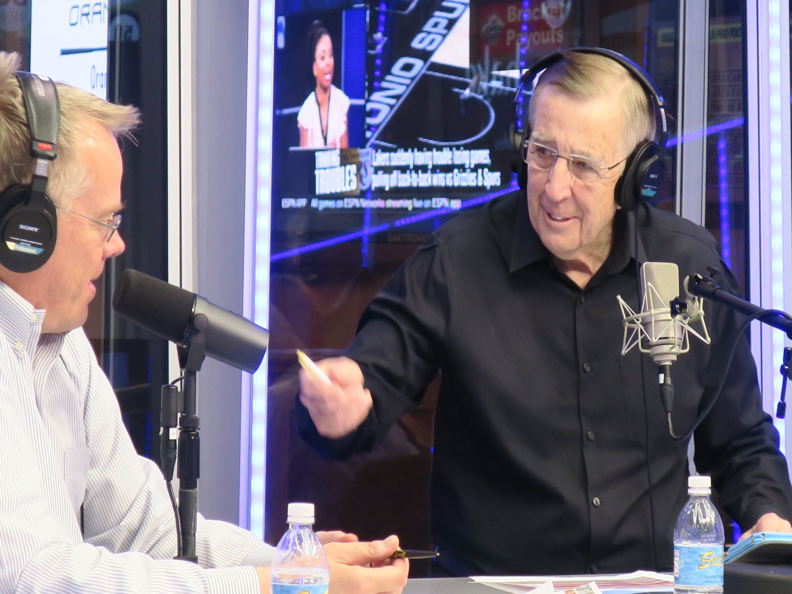
Studio Naming Rights

Slide 2
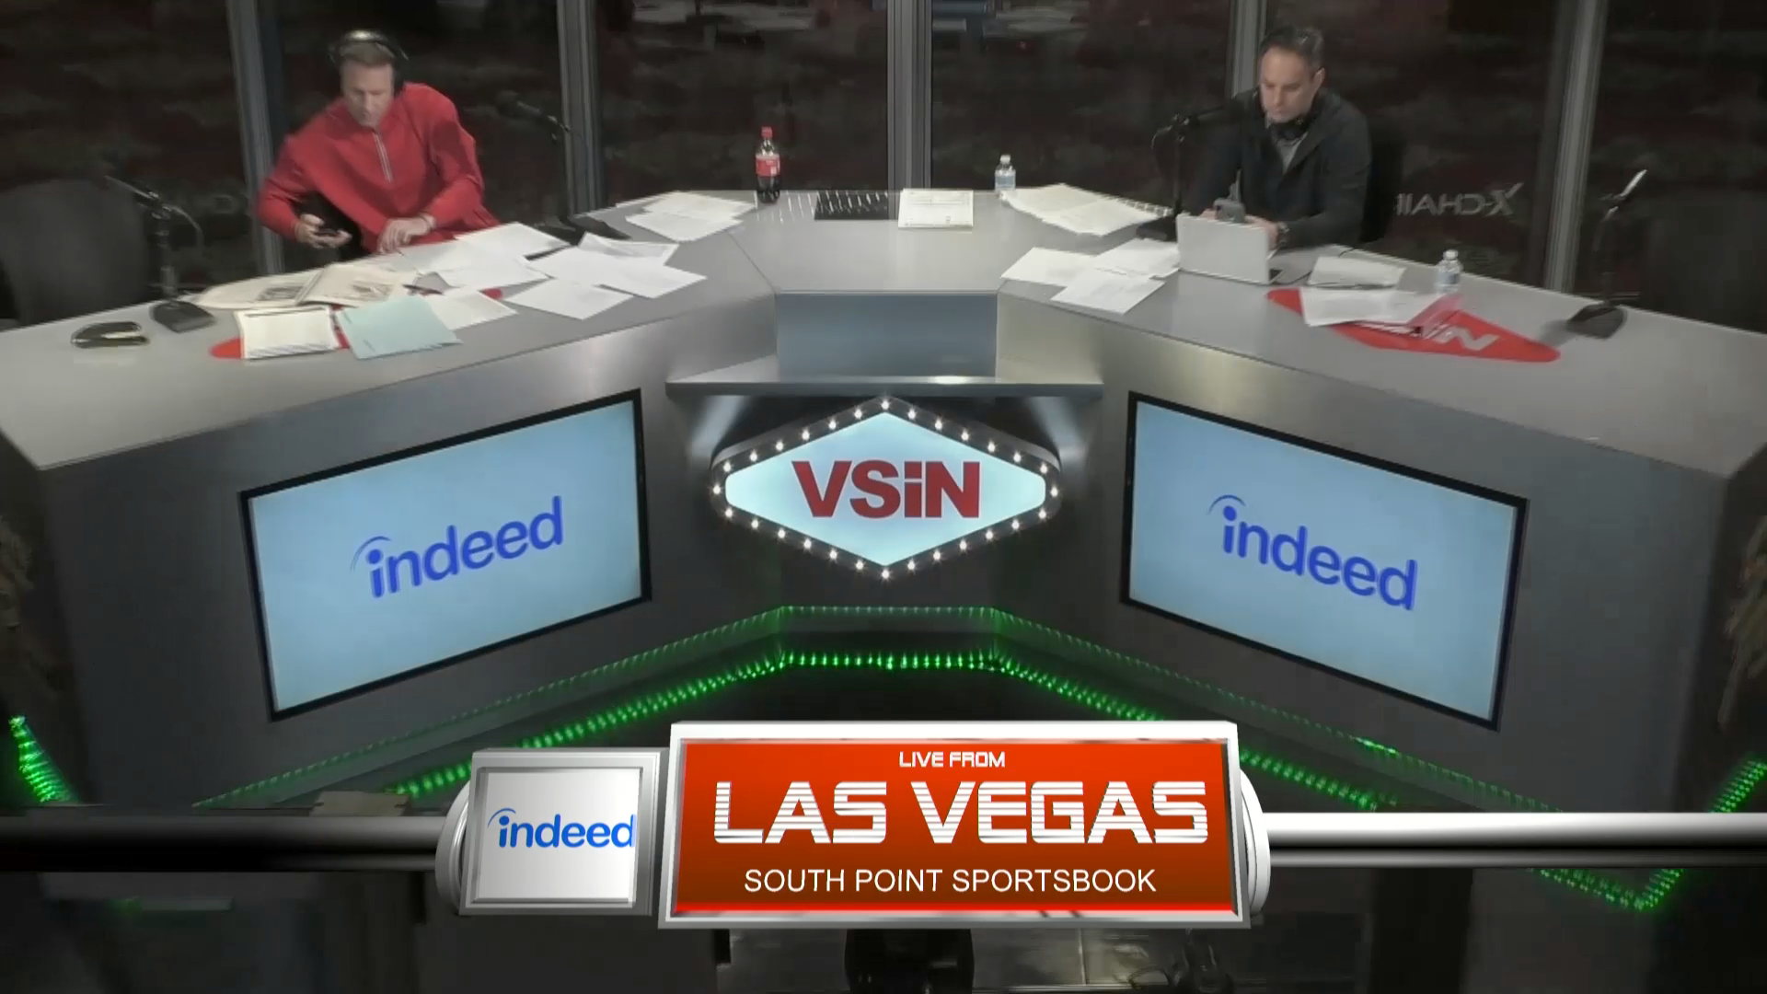
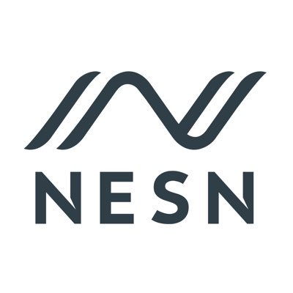
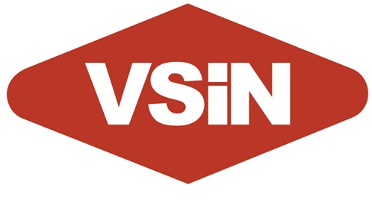


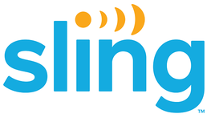

Slide 3
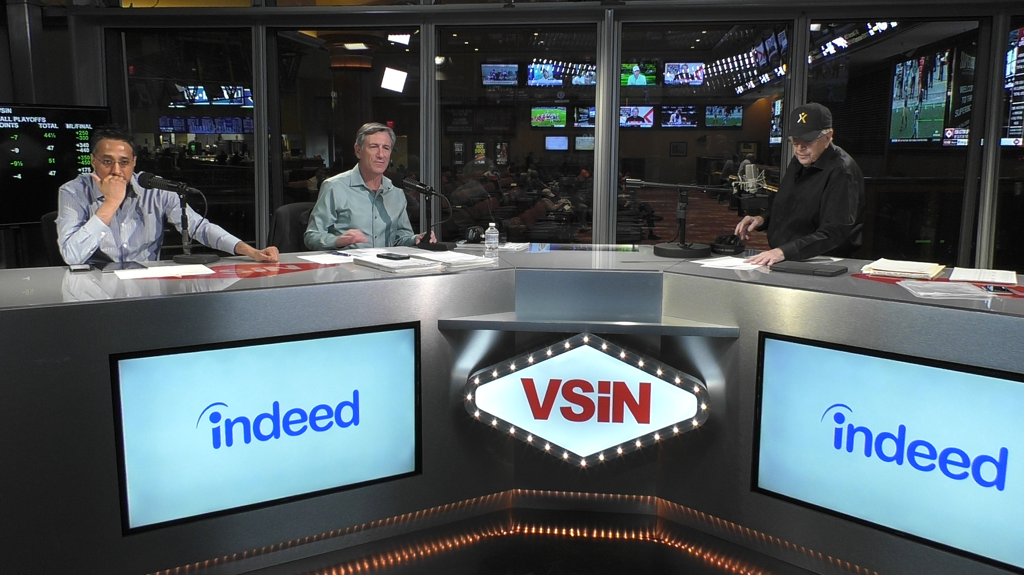
LOGO ON-SCREEN 2 X PER HOUR
2 ON-AIR MENTIONS PER HOUR
(1) 30-SECOND COMMERCIAL PER HOUR

Slide 4
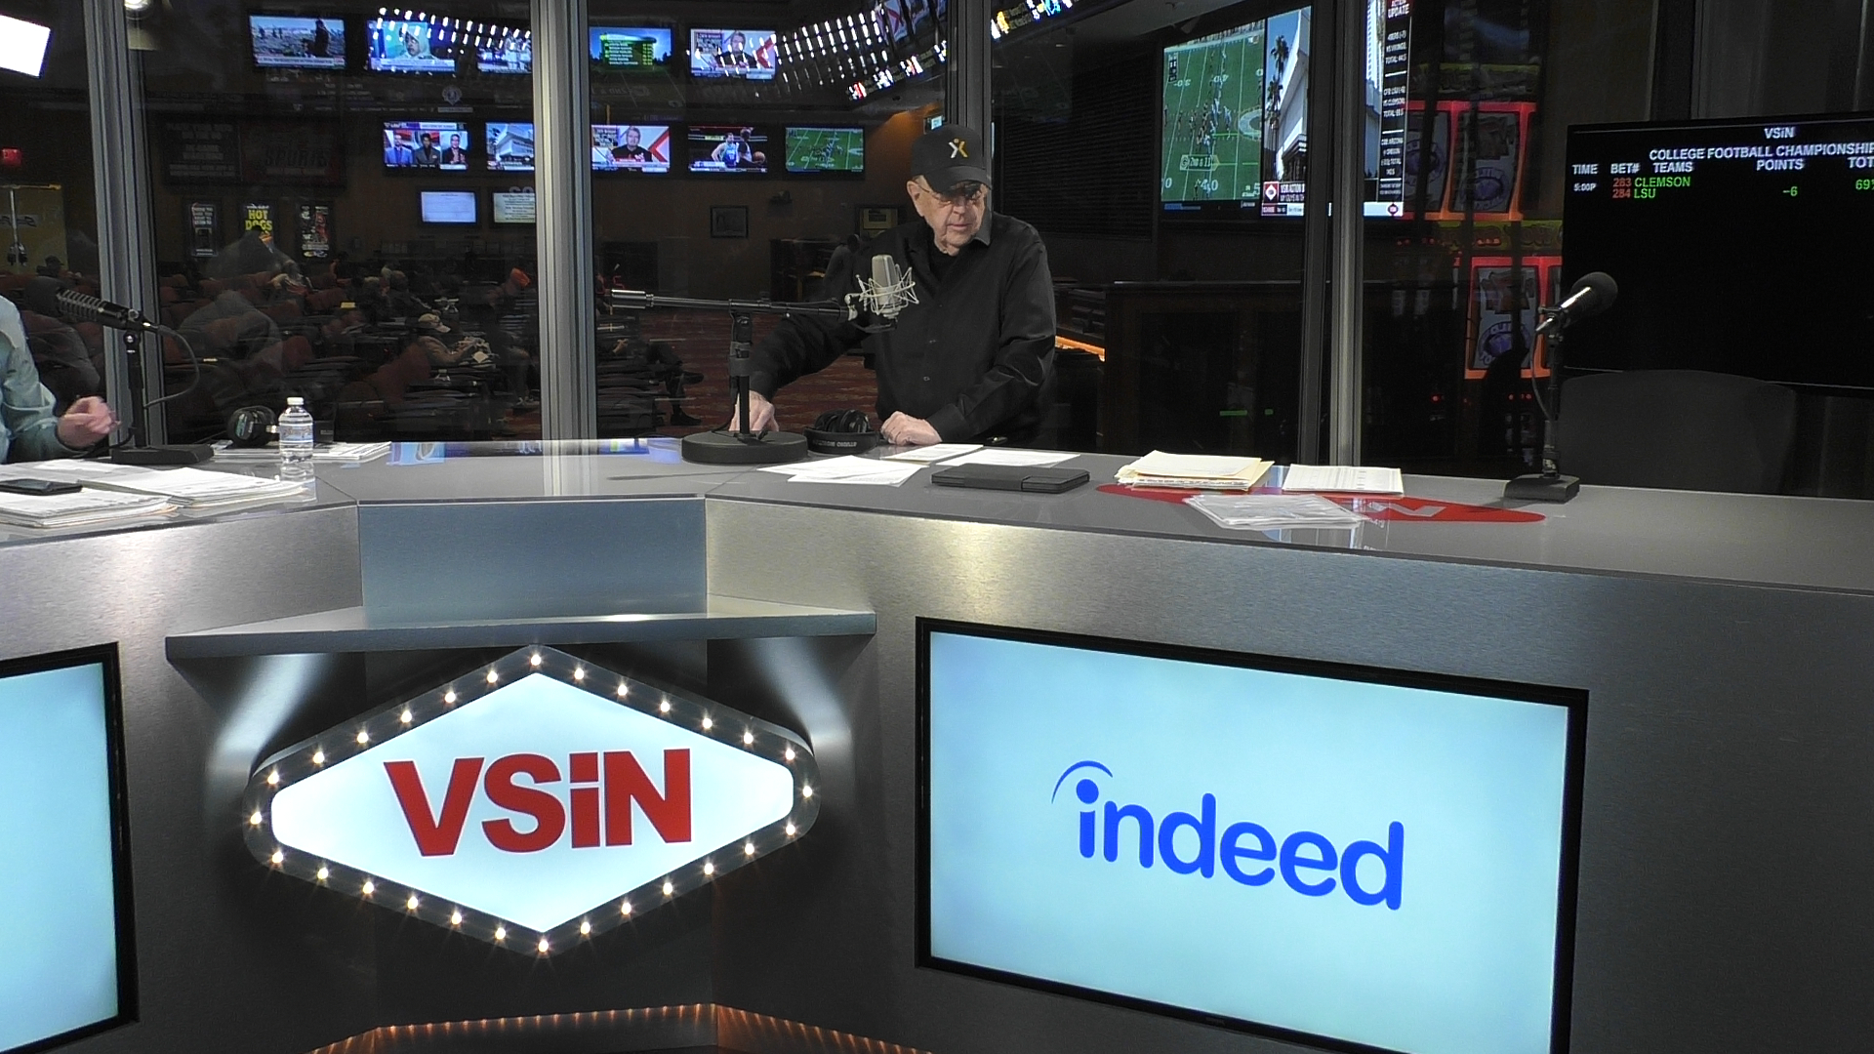

52-WEEK CAMPAIGN: FROSTED LOGO ON GLASS

Slide 5
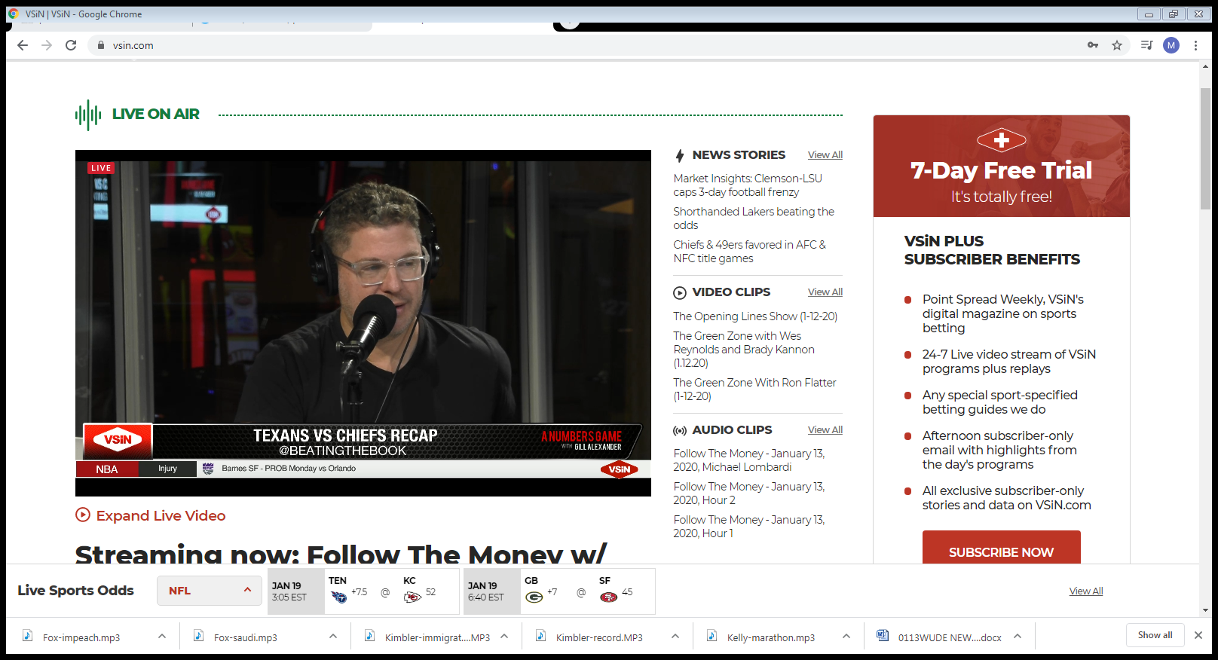


Digital branding
Studios
Studios

Slide 6
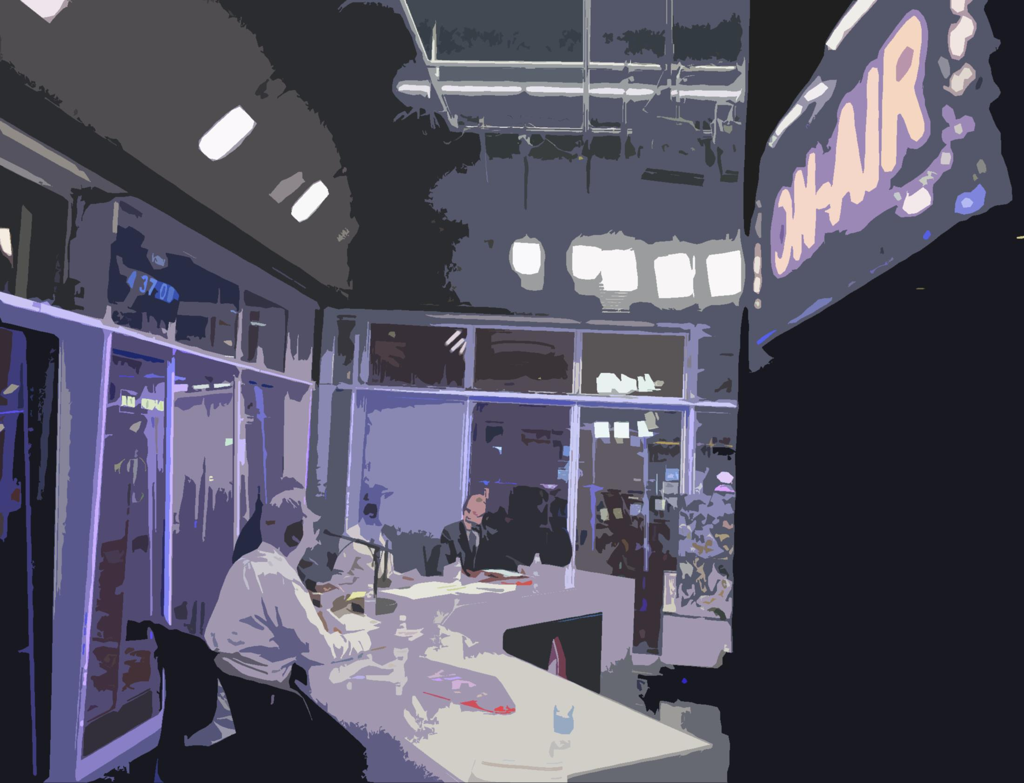





INVENTORY

Slide 7




INVENTORY

Slide 8
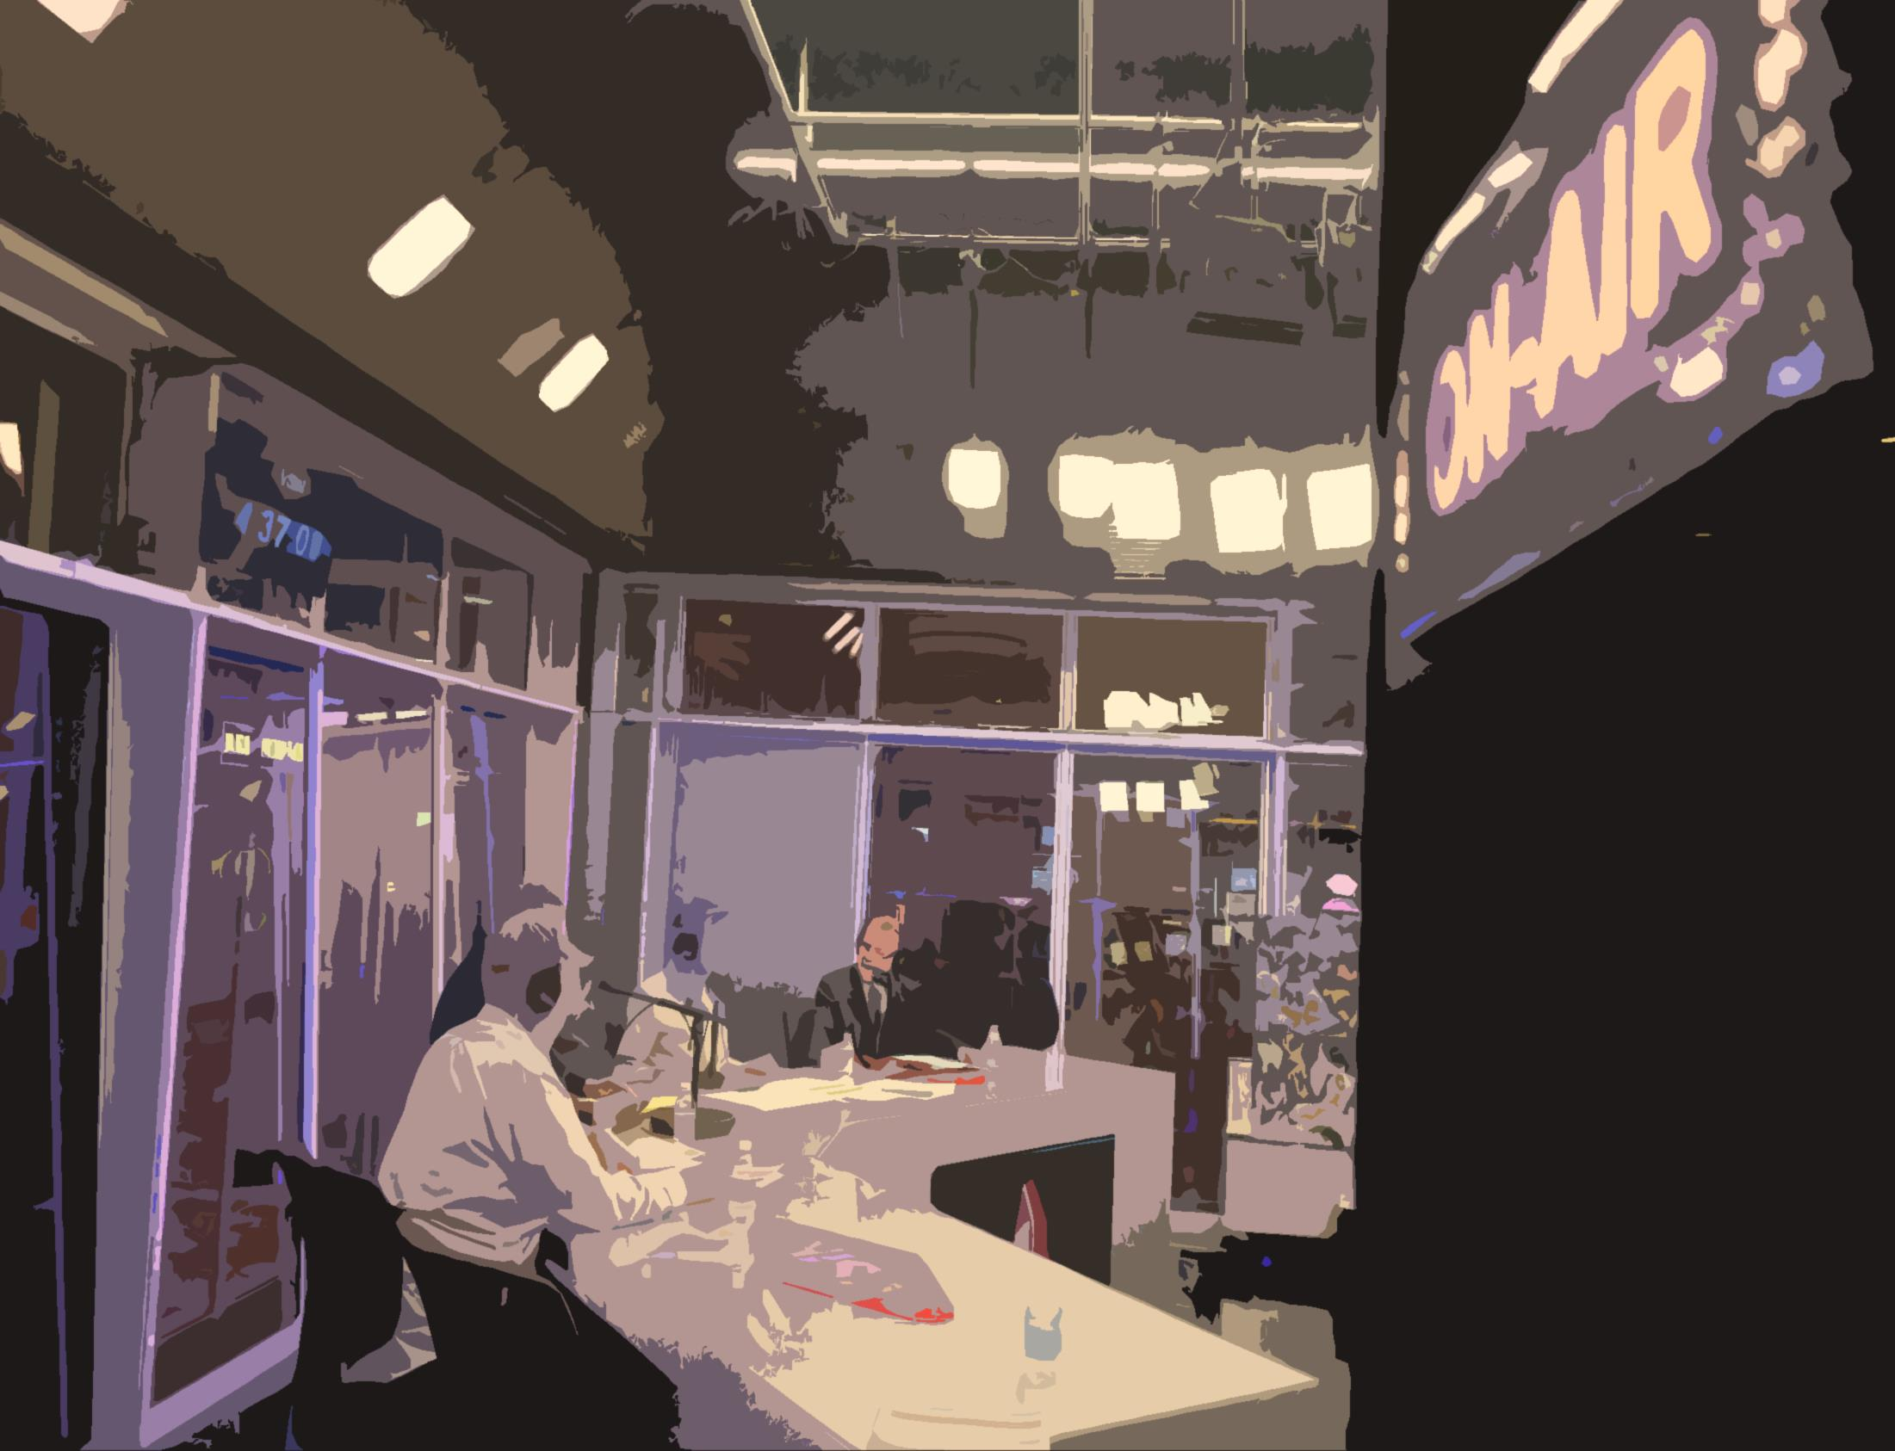

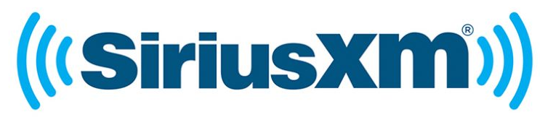

INVENTORY

Slide 9
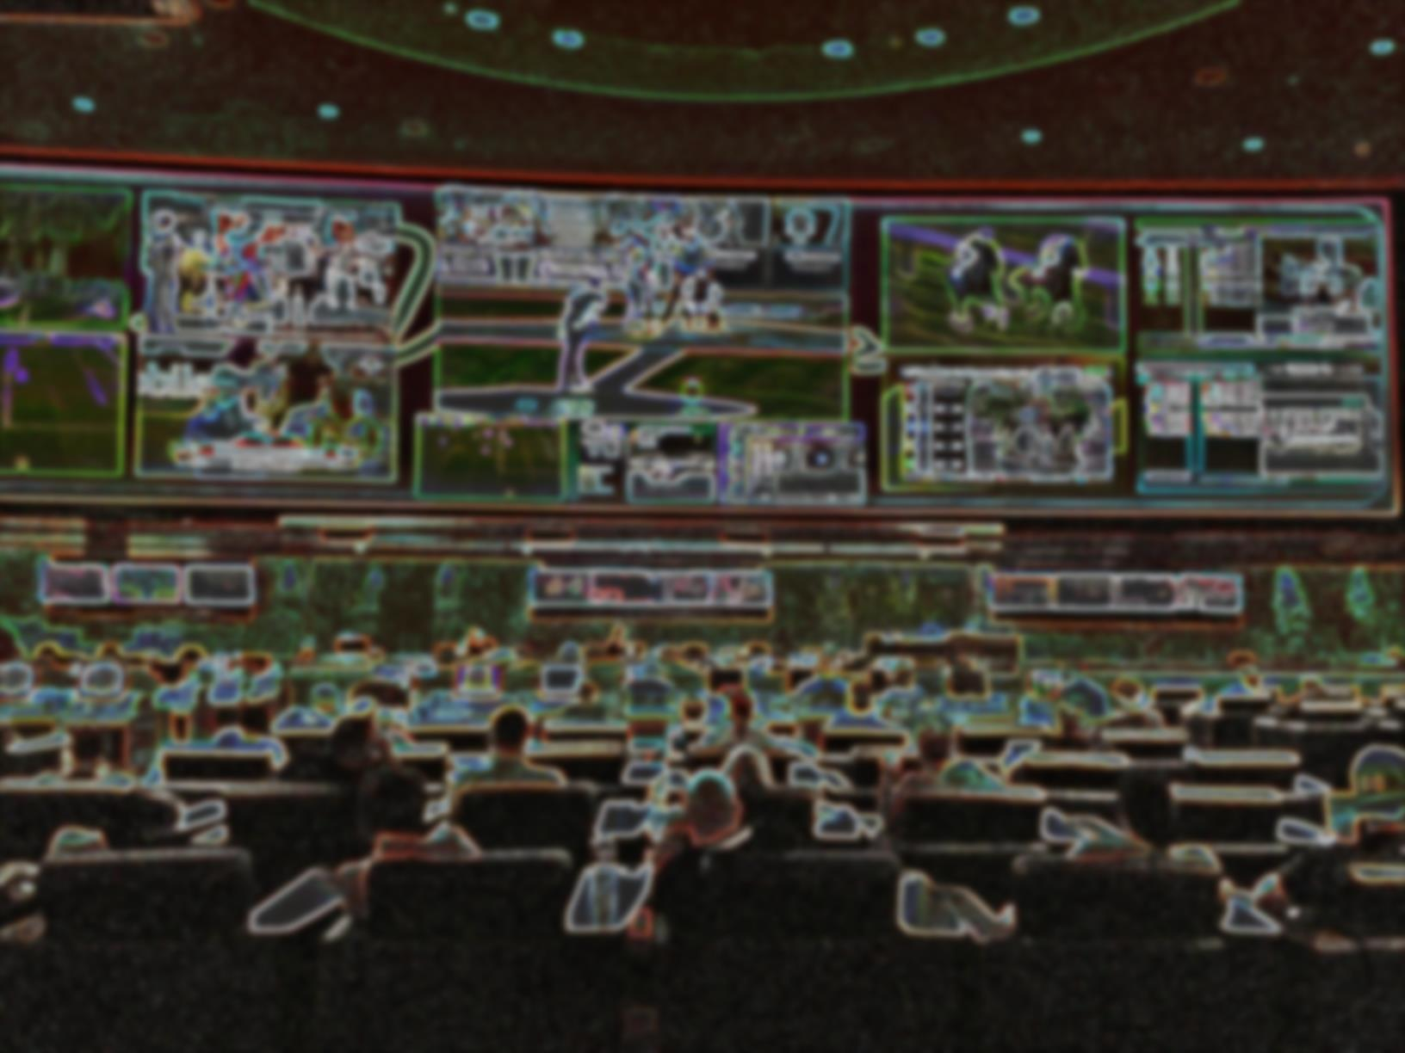

31-MILLION MONTHLY IMPRESSIONS*
26-WEEK CAMPAIGN: $200,000
52-WEEK CAMPAIGN: $400,000
*Audience data provided by networks and represent impressions, not households.

