Slide 1
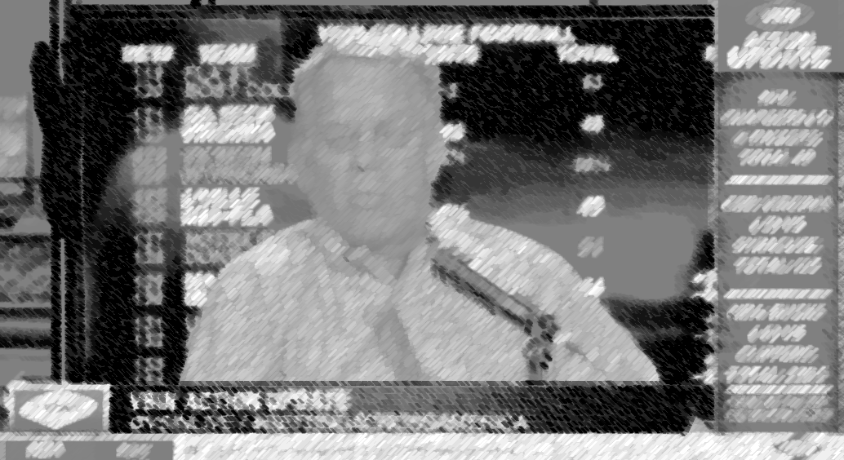

ACTION UPDATE
PRESENTING SPONSOR

Slide 2




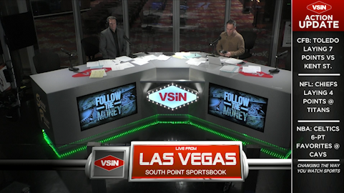


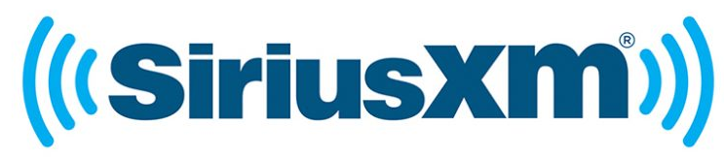

MULTIPLE MEDIA PLATFORMS

Slide 3
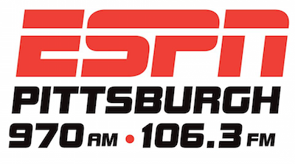
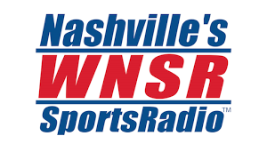
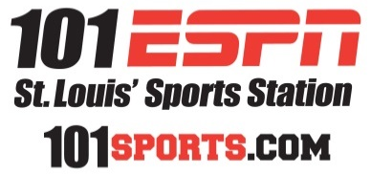
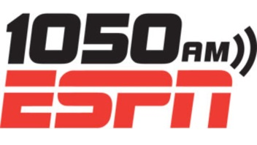


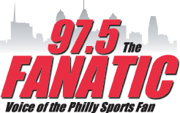
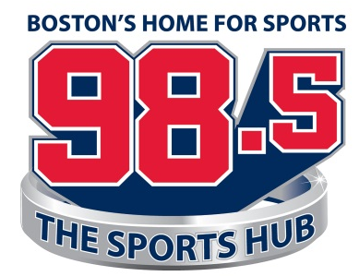


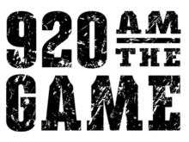
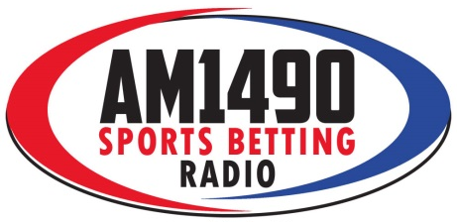
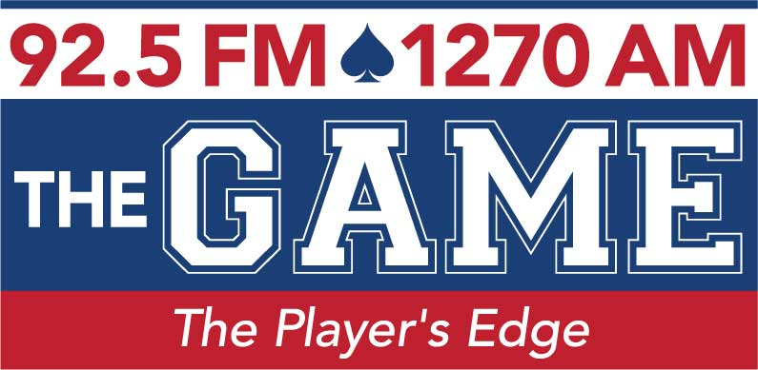
Nashville
St. Louis
New York
Chicago
Philadelphia
Boston
San Francisco
Portland
Louisville
Las Vegas
Pittsburgh
Atlantic City
Reno

Slide 4

TV & DIGITAL PLATFORMS
LOGO ON-SCREEN DURING 1:00 & 4:00 ACTION UPDATES

Slide 5
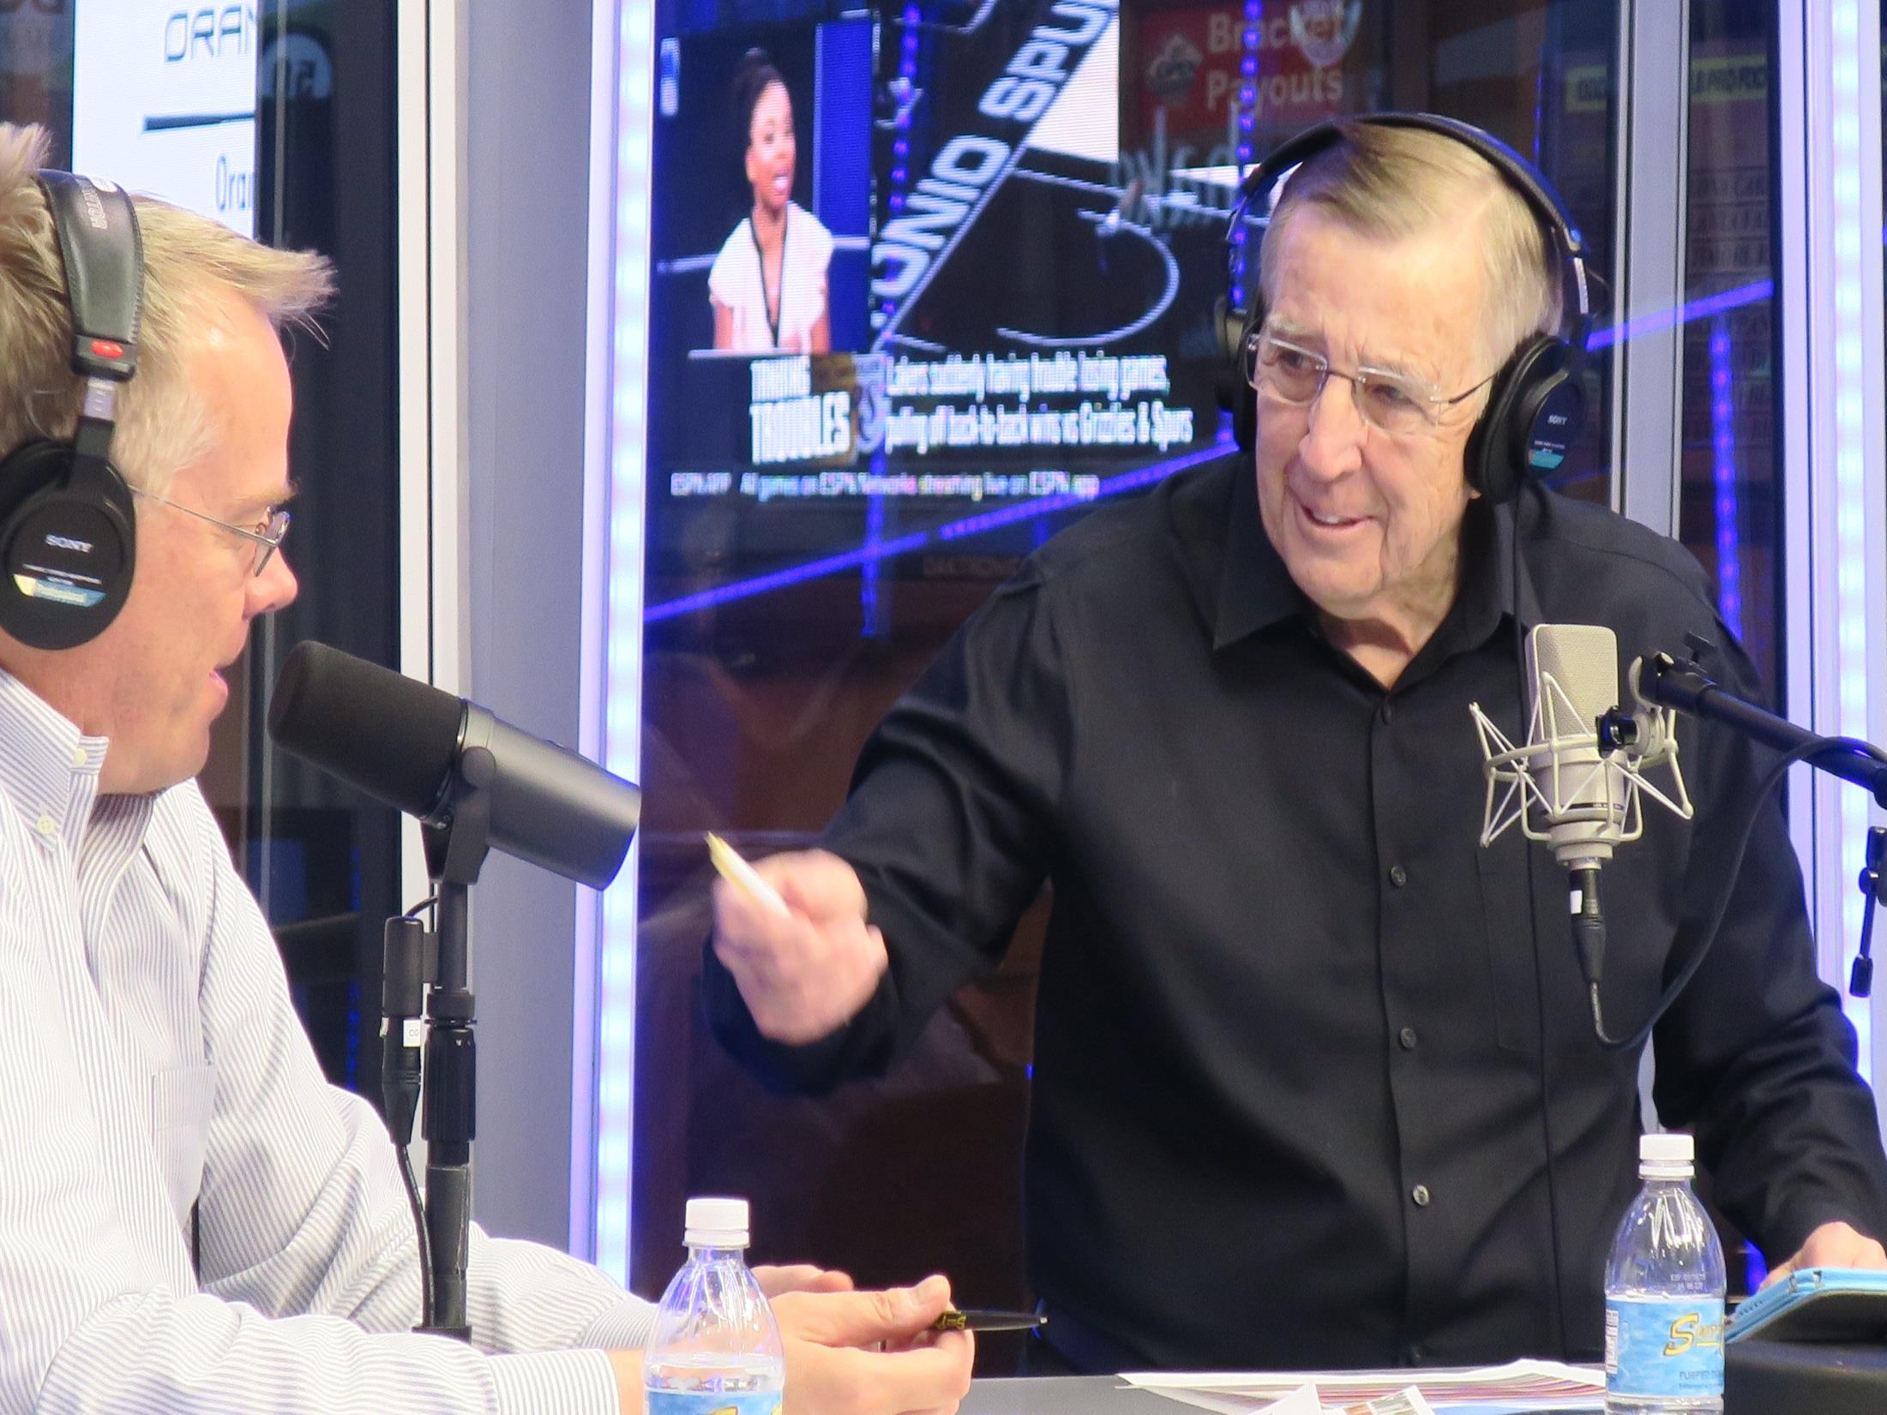
PRESENTING SPONSOR COPY
BRENT MUSBURGER’S indeed
ACTION UPDATE
BRENT MUSBURGER’S ACTION UPDATE POWERED BY indeed
Indeed PRESENTS
BRENT MUSBURGER’S ACTION UPDATE

Slide 6
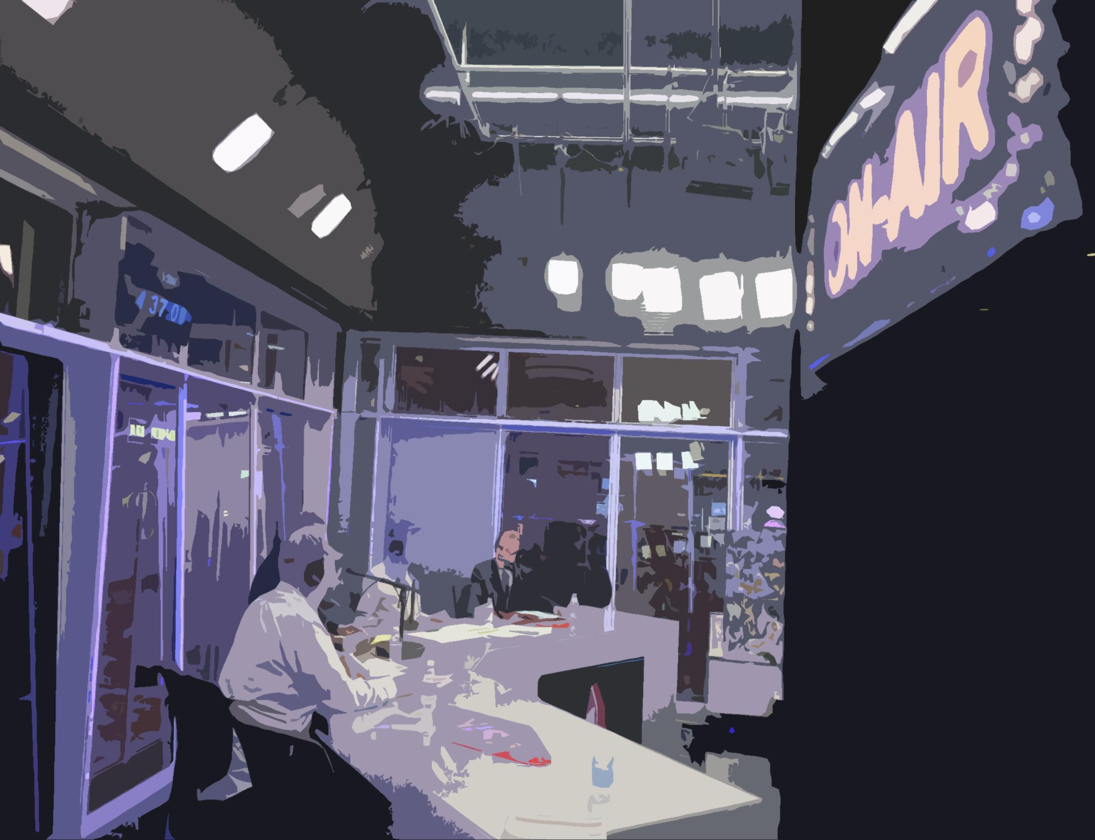
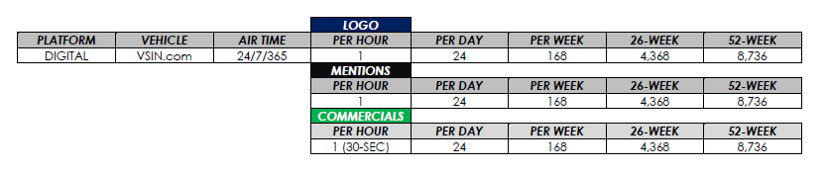

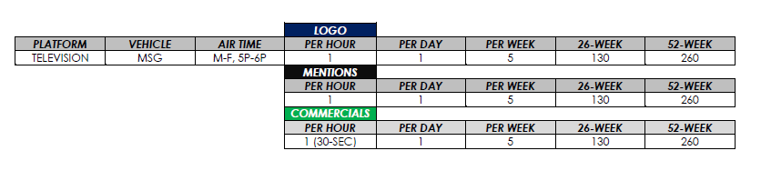
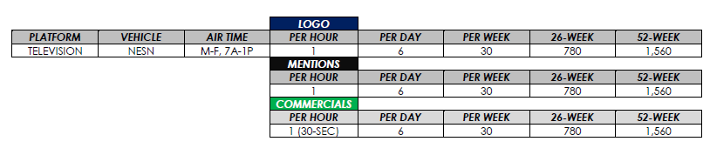
INVENTORY

Slide 7
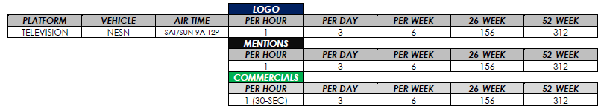
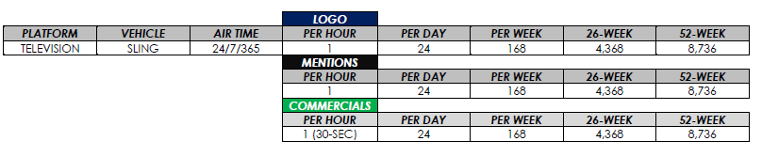

INVENTORY

Slide 8
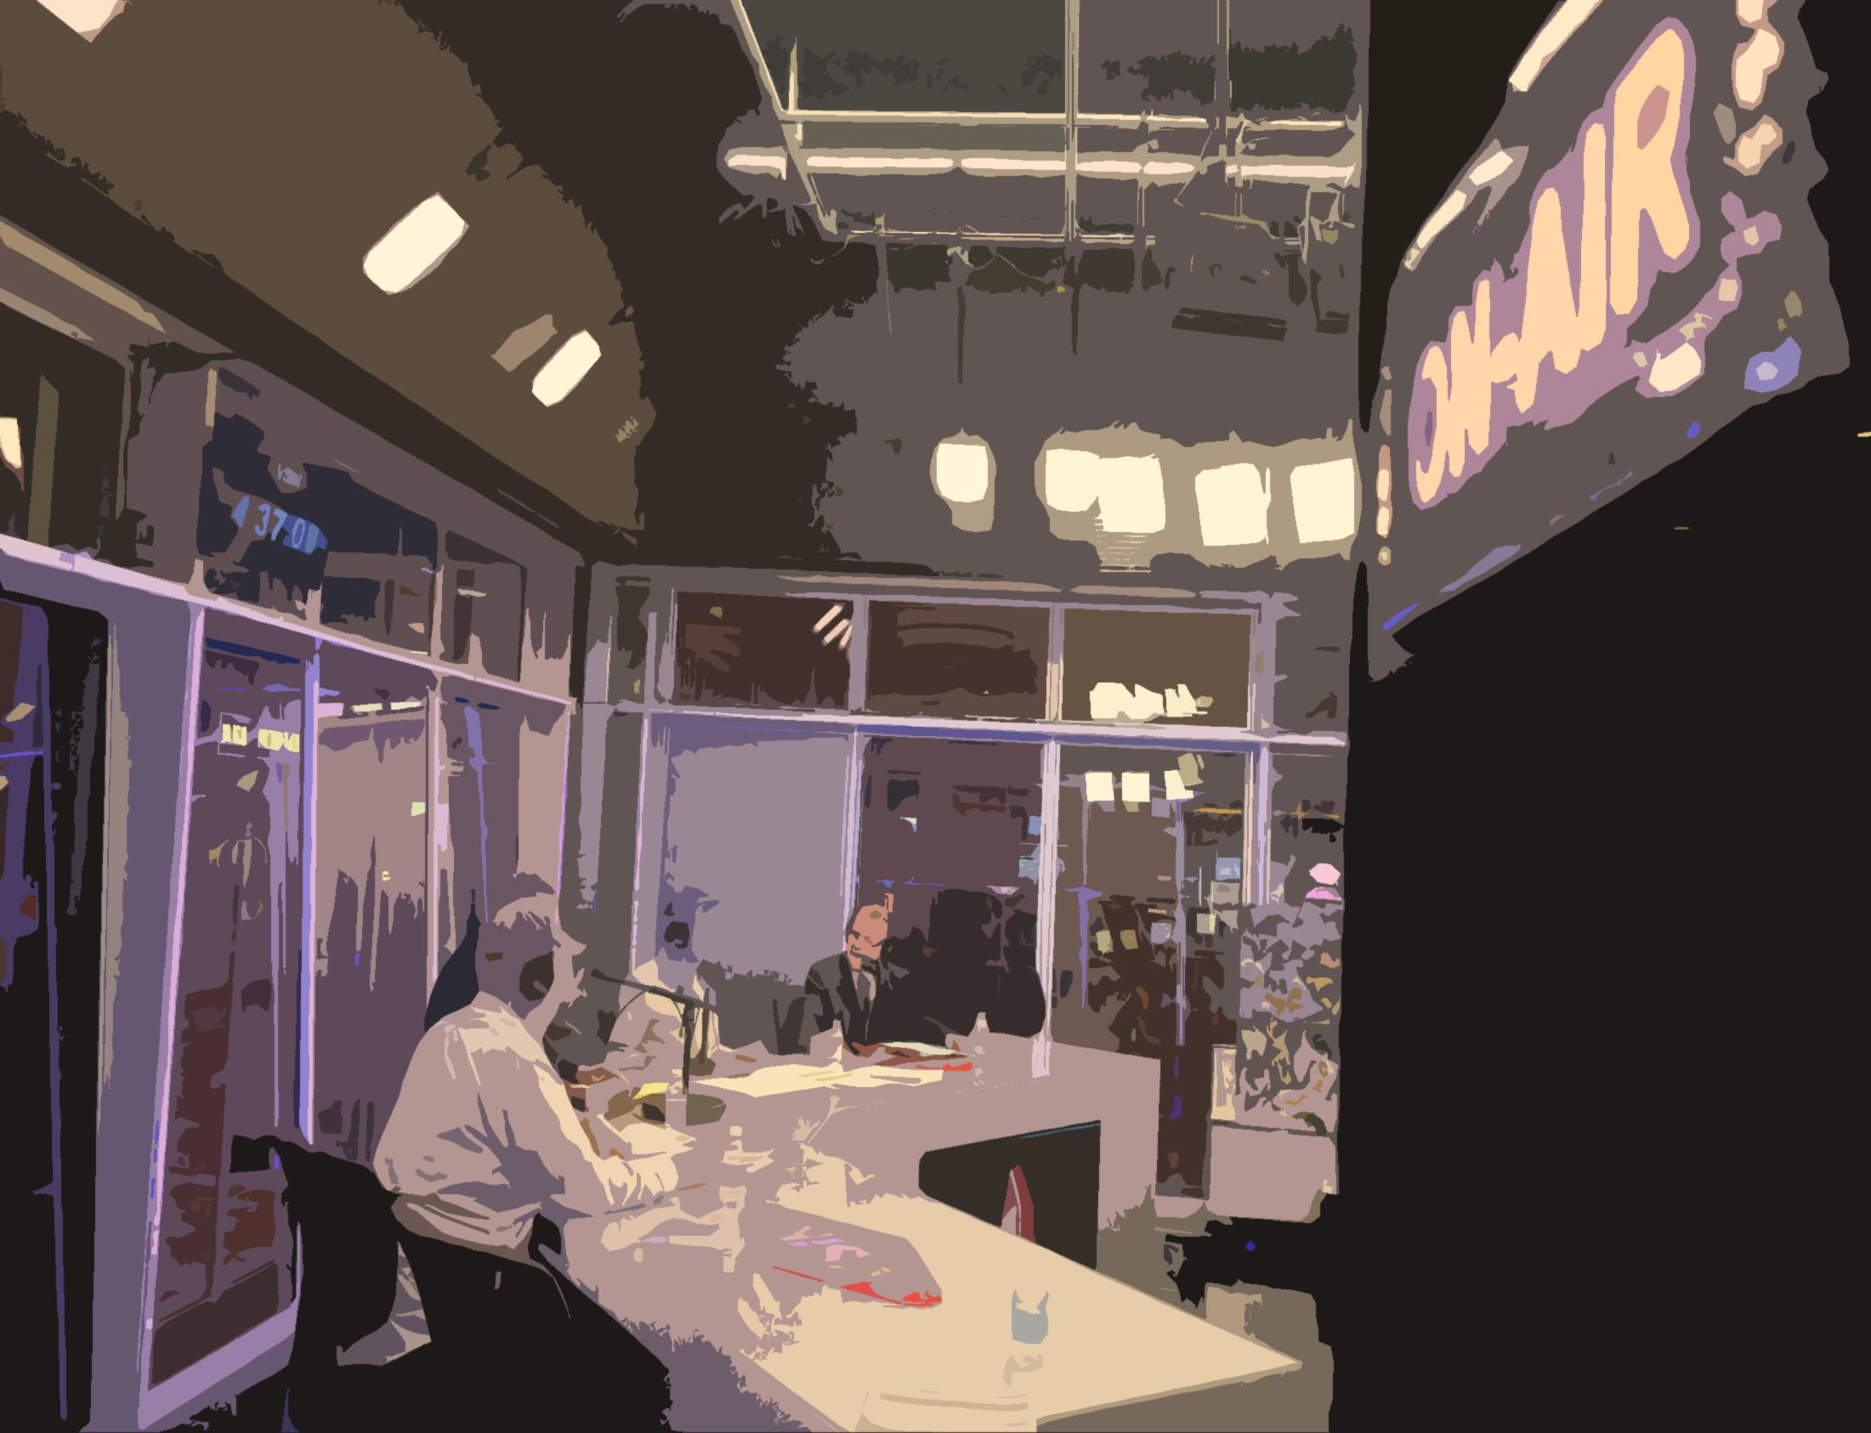
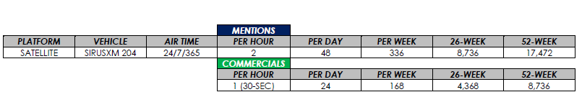
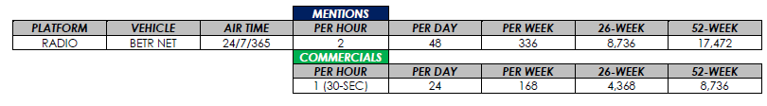
INVENTORY

Slide 9
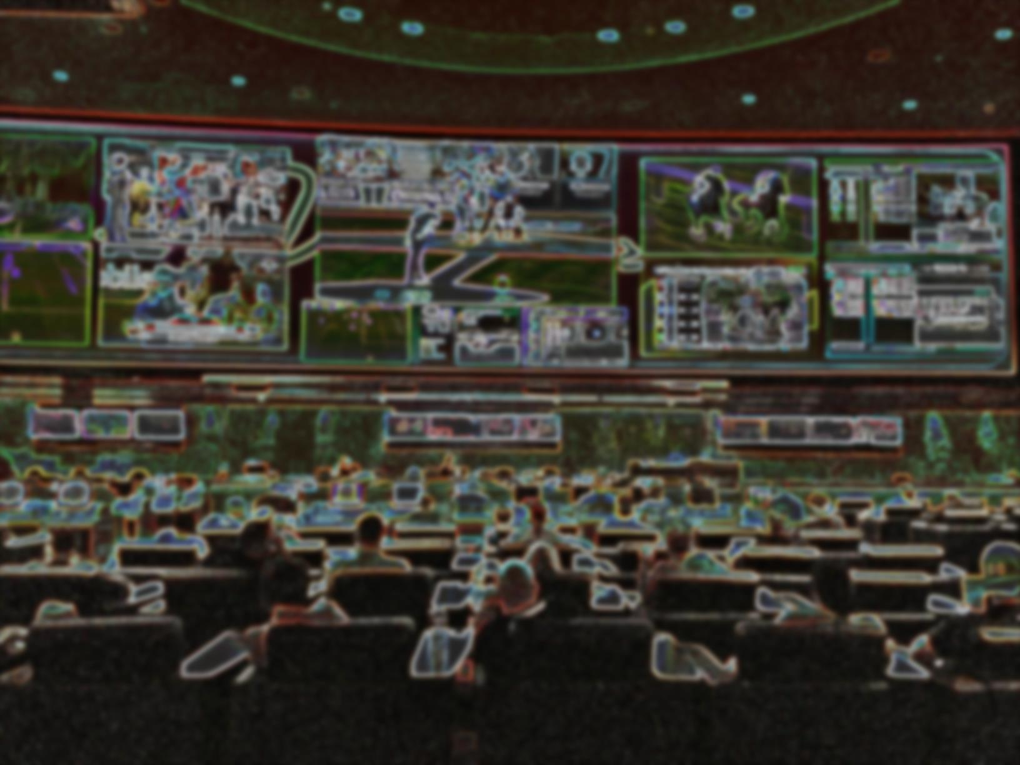

31-MILLION MONTHLY IMPRESSIONS*
26-WEEK CAMPAIGN: $100,000
52-WEEK CAMPAIGN: $200,000
*Audience data provided by networks and represent impressions, not households.

