Slide 1





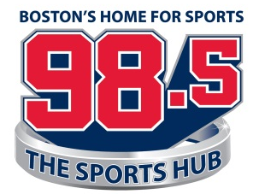








Brent Musburger’s Action Update
Vegas Stats & information Network
New York
Chicago
Boston
OVERVIEW
Gow Media produces and distributes the Brent Musburger Action Update for the Vegas Stats & Information Network (VSiN). The short-form feature delivers relevant, real-time sports betting news and information.
SPORTS BETTING
The recent U.S. Supreme Court ruling has sparked an unprecedented expansion of sports gambling in the United States. Sports gambling is going mainstream, and there are millions hungry for sports gambling content.
EFFECTIVE
Our Action Updates wrap your advertising message around essential content that the listener wants to hear. This will help your advertising message to cut through the clutter and deliver an significant impact for your business.
CONSISTENT
The VSiN updates air during morning and afternoon drive on many of the biggest radio brands in the country, including: 1050 ESPN New York (WEPN-AM); Boston’s 98.5 The Sports Hub; 890 WLS-AM in Chicago; and Philadelphia’s 97.5 The Fanatic (WPEN-FM).
AFFORDABLE
With each live read, the legendary Brent Musburger will wrap your advertising message around content the listener wants to hear during prime time on many of the biggest sports radio stations in the country.
Philadelphia
San Francisco
Houston
St. Louis
Portland
Pittsburgh
Louisville

