Slide 1



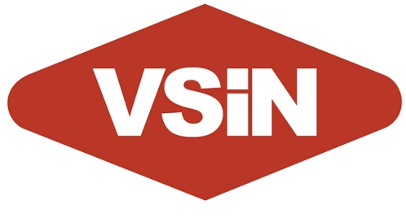










Brent Musburger’s Action Update
Vegas Stats & information Network
New York
Chicago
Boston
OVERVIEW
Brent Musburger’s Action Update from the Vegas Stats & information Network (VSiN) delivers listeners relevant, real-time sports betting news and information.
SPORTS BETTING
In 2018, the U.S. Supreme Court overturned a federal law that banned betting on sports, sparking an incredible expansion of sports betting in the United states. Sports gambling is going mainstream, and there are millions hungry for this content.
CUSTOMIZED FOR YOUR MARKET
The Action Update delivers customized content that focuses on your teams, your scores with betting news and information that matters most to your listeners. Our customization doesn’t end there. In fact, we include your branding and even your sponsors in the updates. Just tell us how you want your update to sound and we’ll take care of the rest.
MARKET-EXCLUSIVE & 100% BARTER
Brent Musburger’s VSiN Action Update is market exclusive, so your station or group will be the only one in the market featuring this sports broadcasting icon. There’s no investment for this exclusivity. This service is 100% barter.
Philadelphia
San Francisco
Houston
St. Louis
Portland
Pittsburgh
Louisville

