Slide 1



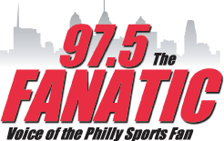


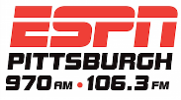

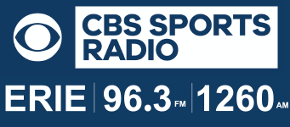



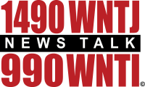




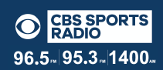

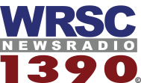
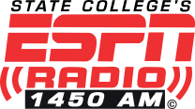

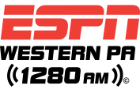



PITTSBURGH
REACHING SPORTS BETTORS
PENNSYLVANIA
$2020 PER WEEK IN 2020
OVERVIEW
As the presenting sponsor of Brent Musburger’s Action Update and The BetR Network, BETMGM advertising will air on our 29 terrestrial radio affiliates in Pennsylvania.
ACTION UPDATES POWERED BY BETMGM
Each Action Update that airs in both states will include “powered by BETMGM” wrapped around essential content that the listener wants to hear. This will help your advertising message to cut through the clutter and deliver a significant impact with your target audience.
RADIO AFFILIATES
BETMGM advertising will air 6A-7P on 97.5 The Fanatic in Philadelphia; ESPN Pittsburgh; Erie’s Classic Rock Z-102.3; and State College’s 99.5 The Bus, among others
COPY SPLITTING on THE BETR NETWORK
The BetR Network can “copy split” your advertising message to deliver your message to just our affiliates in Pennsylvania.
$2,020 PER WEEK FOR 2020
In 2020, we’re offering 20 “live reads” and 20, 30-second commercials each week on our Action Update and BetR Network affiliates in Pennsylvania for just $2,020 per week. Annual contract is $105,040. A minimum one-quarter investment of $26,260 is required to participate in this special offer.
PHILADELPHIA
PITTSBURGH
ERIE
WHEELING
CUMBERLAND
ALTOONA
CUMBERLAND
JOHNSTOWN
HARRISBURG
STATE COLLEGE
NORTHWEST PA
wheeling

