Slide 1

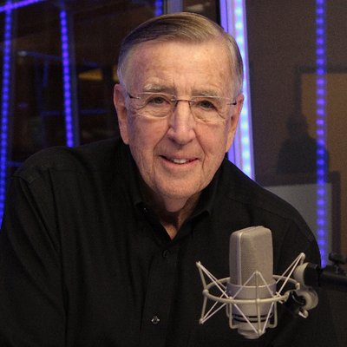
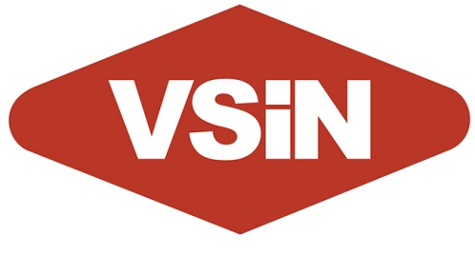
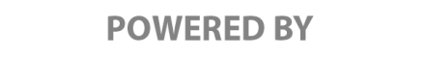
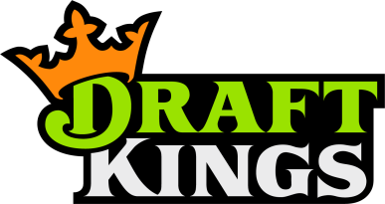
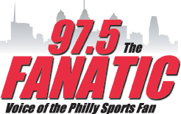
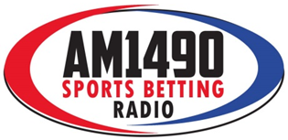
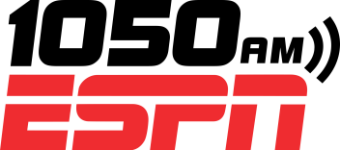
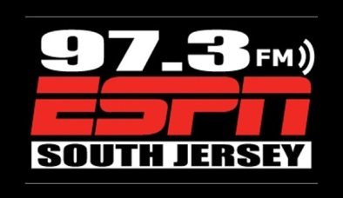
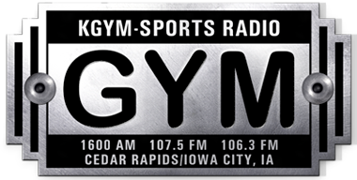

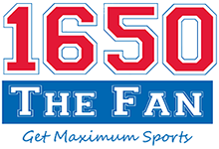
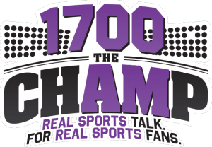
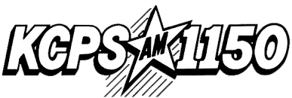
REACHING SPORTS BETTORS
IOWA & NEW JERSEY
$2020 PER WEEK IN 2020
OVERVIEW
As the presenting sponsor of Brent Musburger’s Action Updates and The BetR Network, Draft Kings advertising will air on our terrestrial radio affiliates in both Iowa and New Jersey.
ACTION UPDATES POWERED BY POINTSBET
Each Action Update that airs in both states will include “powered by Draft Kings” wrapped around essential content that the listener wants to hear. This will help your advertising message to cut through the clutter and deliver an significant impact with your target audience.
RADIO AFFILIATES
Draft Kings’ advertising message will air 6A-7P on 1050 ESPN in New York; 97.5 The Fanatic in Philadelphia; ESPN Atlantic City; and Lazer 103.3 in Cedar Rapids, among others.
COPY SPLITTING on THE BETR NETWORK
The BetR Network can “copy split” your advertising message to deliver your message to just our affiliates in Iowa and New Jersey. In addition, we can deliver specific advertising messages to each state, so you can deliver different promotions in each state.
$2,020 PER WEEK FOR 2020
In 2020, we’re offering 20 “live reads” and 20, 30-second commercials each week on our Action Update and BetR Network affiliates in Iowa & New Jersey for just $2,020 per week. Annual contract is $105,040. A minimum one-quarter investment of $26,260 is required to participate in this special offer.
NEW YORK, NY
PHILADELPHIA, PA
ATLANTIC CITY, NJ
ATLANTIC CITY, NJ
CEDAR RAPIDS, IA
BURLINGTON, IA
CEDAR FALLS, IA

