Slide 1

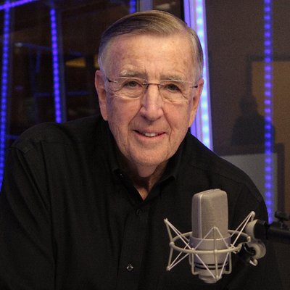

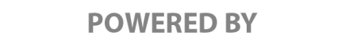


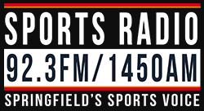
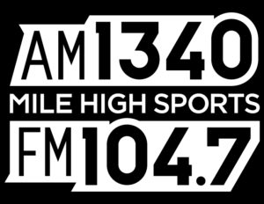

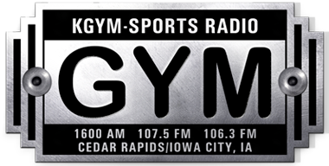

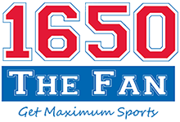
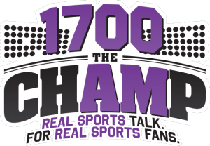

REACHING SPORTS BETTORS
COLORADO, ILLINOIS, & IOWA
$2020 PER WEEK IN 2020
OVERVIEW
As the presenting sponsor of Brent Musburger’s Action Update and The BetR Network, PointsBet advertising will air on our terrestrial radio affiliates in Colorado, Illinois, and Iowa.
ACTION UPDATES POWERED BY POINTSBET
Each Action Update that airs on our radio affiliates will include “powered by PointsBet” wrapped around essential content that the listener wants to hear. This will help your advertising message to cut through the clutter and deliver an significant impact with your target audience.
RADIO AFFILIATES
PointsBet’s advertising message will air on the legendary 890 WLS in Chicago; Mile High Sports in Denver; and Classic Rock Lazer 103.3 in Cedar Rapids, Iowa, among others.
COPY SPLITTING on THE BETR NETWORK
The BetR Network can “copy split” your advertising message to target specific states. This means different
$2,020 PER WEEK FOR 2020
In 2020, we’re offering 20 “live reads” and 20, 30-second commercials each week on our Action Update and BetR Network affiliates in Colorado, Illinois, and Iowa for just $2,020 per week. Annual contract is $105,040. A minimum one-quarter investment of $26,260 is required to participate in this special offer.
CHICAGO, IL
SPRINGFIELD, IL
DENVER, CO
ASPEN, CO
CEDAR RAPIDS, IA
BURLINGTON, IA
CEDAR FALLS, IA

