Slide 1

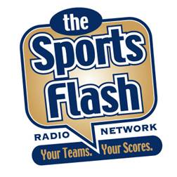
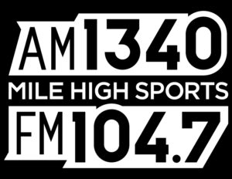
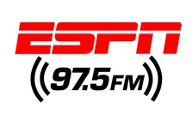
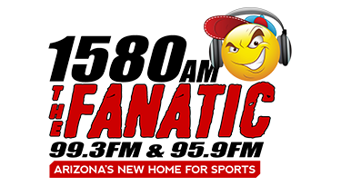
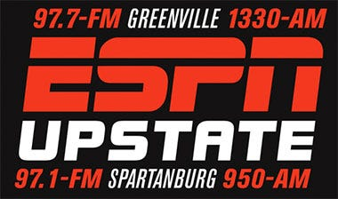
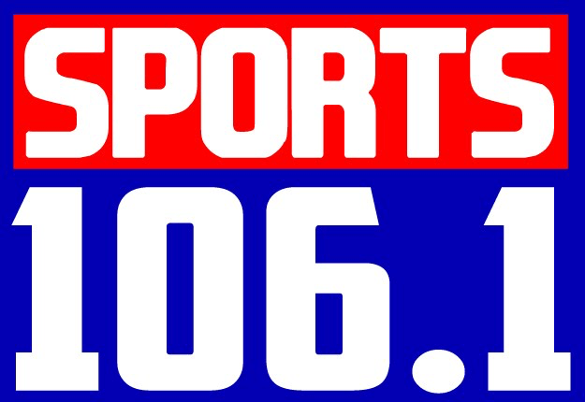
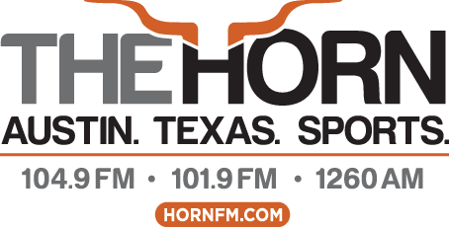
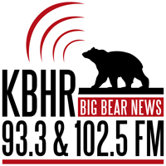
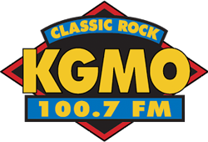
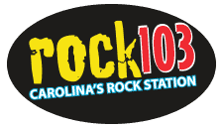
505
RADIO STATIONS
Overview
“The Sports Flash” Radio Network driven by JEEP delivers customized, local sports reports to 505 network affiliates across the country, reaching more than 8.3-million listeners each week.
Effective
Our award-winning sports broadcasters deliver updates that wrap your advertising message around content that the listener wants to hear, cutting through the clutter, and ensuring a greater impact for your advertising message.
Consistent
Each year, we deliver more than 390,000 “Sports Flash” updates to our network affiliates around the country and we’ll include your message in every single one of them.
Affordable Billboards
As our title sponsor, we will brand each of our updates with your advertising message.
Flexible
The advertising message can be changed daily, weekly, or monthly. Target your advertising message station-by-station to micro-target our audience.
Commercials
In addition to branding each update with your message, you will receive two, 30-second commercials each week on each station.
Investment
For a $195,000 annual investment, you will own a piece of valuable radio “real estate” on 505 stations across the country.
8.3-MILLION
WEEKLY LISTENERS
DENVER
HOUSTON
PHOENIX
GREENVILLE, SC
RICHMOND
AUSTIN
BIG BEAR, CA (LA DMA)
CAPE GIRARDEAU
RALEIGH-DURHAM-FAYETTEVILLE
National

