Slide 1
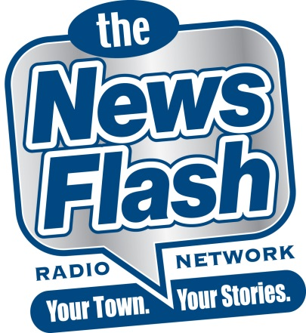
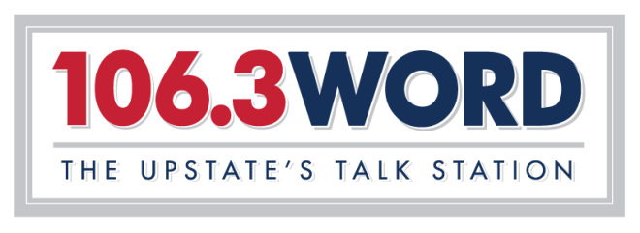
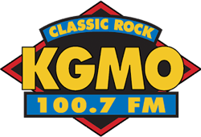
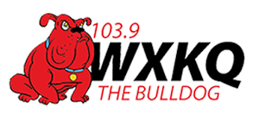
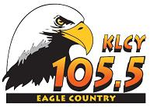

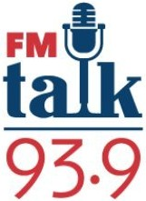
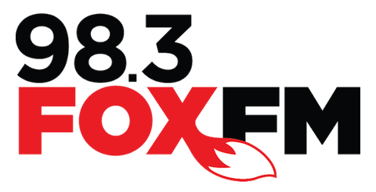

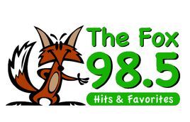
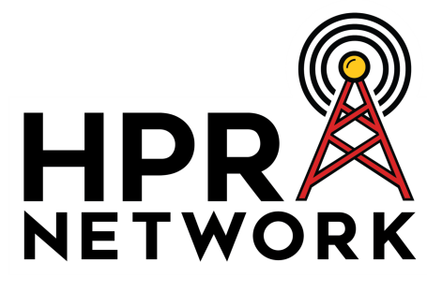
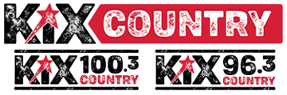
100 AFFILIATES
“The News Flash”
Radio Network
Overview
“The News Flash” Radio Network delivers customized, local news reports to 100 network affiliates.
Your town. Your stories.
Our award-winning news anchors deliver customized news that focuses on the people and communities of each station’s listening area. This is LOCAL news, not NATIONAL headlines. Our reports rarely, if ever, mention national politics.
News for music-intensive stations
We specialize in headline-orientated news reports for music-intensive stations. Our updates are heard on a variety of formats, including: adult contemporary; hot AC; top 40; country; and classic rock.
News you can use
We’re news, not opinion. We’re schools, not political squabbling. We’re community, not crime. We’re families, not factions. We deliver news that affects the listener each and every day with news and information that the listener can use in their daily life.
Morning drive inventory
“The News Flash” delivers inventory that will air in morning drive on all affiliates, Monday-Friday. Our inventory airs as an immediate adjacency to the “News Flash” updates or we can air your commercials as a separate schedule if you want greater separation between the news content and the commercial.
This “News Flash” a service of . . .
“The News Flash” delivers morning drive commercial inventory. In addition, we can band our updates with your advertising message in the form of “billboards” prior to the update that let listeners know that the updates are a service of your business.

