Slide 1


AUDIO PLATFORMS - 2024

Slide 2


AM DRIVE, PM DRIVE, ROS (6A-7P)
644 AFFILIATES
3:00/STATION
-UPDATE BRANDING
-15s/30s/60s
-SPORTS, NEWS/TALK, COUNTRY, CLASSIC ROCK, HOT AC, CLASSIC HITS, TOP 40
AM NEWS (6A-10A)
182 AFFILIATES
3:00/STATION
-BILLBOARDS
-15s/30s/60s
-SPORTS, NEWS/TALK, COUNTRY, CLASSIC ROCK, HOT AC, CLASSIC HITS, TOP 40
-LOCAL NEWS LISTENERS CAN USE,
NOT POLITICAL

Slide 3
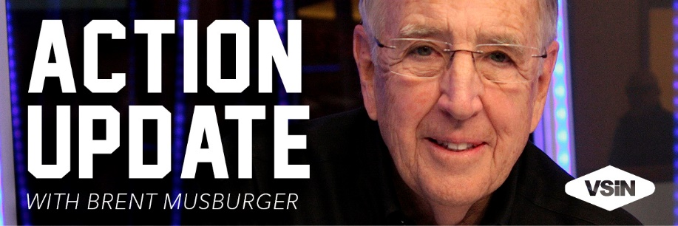
ACTION UPDATE (6A-7P)
281 AFFILIATES
3:00/STATION
-BILLBOARDS
-15s/30s/60s
-SHUT DOWN OF LONG-FORM NETWORK
-ELIMINATES OPEX
-MAINTAINS REVENUE STREAM

Slide 4









24/7/365
48-114 AFFILIATES
5:00/HOUR
-LIVE READS
-BILLBOARDS
-15s/30s/60s
WEEKDAYS
7-10A EASTERN
10A-12P EASTERN
12-1P EASTERN
1-3P EASTERN
3-6 PM EASTERN
6-9 AM EASTERN
9-11 PM EASTERN
11P-2A EASTERN

Slide 5






24/7/365
48-114 AFFILIATES
5:00/HOUR
-LIVE READS
-BILLBOARDS
-15s/30s/60s
WEEKENDS
12-3P EASTERN (SAT/SUN)
8-10A EASTERN (SAT/SUN)
10A-12P EASTERN (SAT/SUN)
3-10P EASTERN (SAT)
3-7P EASTERN (SUN)
10 PM EASTERN (SAT)
7-10 PM EASTERN (SUN)
10 PM EASTERN (SUN)

Slide 6
AUDIO PLATFORMS - 2024

